Slide 1





KAAB Site Visit Team Online Training
2018 Online Training 1/3
Overview of Accreditation Process
KAAB Conditions & Procedure
Member of Canberra Accord

Slide 2
2018 Online Training 1/3
KAAB Site Visit Team Online Training
Overall Procedure of KAAB Accreditation
Site Visit Agenda
Site Visit Team’s Responsibilities & Protocols
Team Room Preparation
Conditions for Accreditation
Visiting Team Report
Confidential Recommendation
Evaluation of the Site Visit

Slide 3
Accreditation Procedures
2018 Online Training 1/3
KAAB Outline Procedure for Initial Accreditation
PROGRAM APPLYING FOR ACCREDITATION
KAAB
Applying for Candidacy Status for Initial Accreditation
Review of Application for Candidacy Status for Initial Accreditation
Applying for Initial Accreditation
Review of Application for Initial Accreditation
Preparation for Architecture Program Report (APR)
Selection of Site Visit Team Members
Review for conflict of interests among proposed visit team members by KAAB
Notifying Finalized Site Visit Team Members to School
Submission of APR
(furnishing of supplemental materials if requested)
Review of Submitted APR and Approval
Preparation for Site Visit Team Room
Adjustment & Finalizing of Detail Site Visit Agenda
Site Visit
Visiting Team Report and Confidential Recommendation Review by KAAB Accrediting Committee
FINAL ACCREDITATION RETIFICATION BY BOARD OF DIRECTORS

Slide 4
Accreditation Procedures
2018 Online Training 1/3
KAAB Outline Procedure for Continuing Accreditation
PROGRAM APPLYING FOR ACCREDITATION
KAAB
Applying for Candidacy Status for Initial Accreditation (1 page short version)
Review of Application for Candidacy Status for Initial Accreditation
Applying for Initial Accreditation
Review of Application for Initial Accreditation
Preparation for Architecture Program Report (APR)
Selection of Site Visit Team Members
Review for conflict of interests among proposed visit team members by KAAB
Notifying Finalized Site Visit Team Members to School
Submission of APR
(furnishing of supplemental materials if requested)
Review of Submitted APR and Approval
Preparation for Site Visit Team Room
Adjustment & Finalizing of Detail Site Visit Agenda
Site Visit
Visiting Team Report and Confidential Recommendation Review by KAAB Accrediting Committee
& FINAL ACCREDITATION RETIFICATION BY BOARD OF DIRECTORS
Annual Report (AR) Submission & Review Process
Non-submittal of AR : Will result in temporary suspension of accreditation
AR Review may result in Focused Site Visit if deemed necessary

Slide 5
Accreditation Procedures
2018 Online Training 1/3
Site Visit & Follow-Up Procedure
Site Visit (for 4 days 3 nights)
Fall & Spring Semester
Writing Visiting Team Report
Completion of Draft VTR at site visit
Work on 2nd Draft (by Team)
Amendment of final Draft (by Team)
Completion of VTR (by Team Chair)
Within 30 days after Site Visit
Completion of Draft VTR at site visit
Work on 2nd Draft (by Team)
Amendment of 2nd Draft (by Team)
Completion of VTR (by Team Chair)
Confirmation of VTR Contents
Program must confirm all contents of the completed VTR
Request for adjustments if necessary (Only factual errors can be adjusted)
Within 30 days after VTR Completion
Review by the program within first 15 days of VTR Completion
Request for adjustments ratified within 15 days of submittal
Decision of Accreditation
VTR and Confidential Recommendation submitted to KAAB
Decision by Accreditation Committee & Submittal to Board of Directors
Within 15 days after Ratified VTR
All VTR’s and Confidential Recommendations collected for Accreditation Committee review
Final decision made by Accreditation Committee
Ratification by Board of Direcors
VTR and Confidential Recommendation submitted to KAAB
Decision by Accreditation Committee & Submittal to Board of Directors
After Decision by Accreditation Committee
All VTR’s and Confidential Recommendations collected for Accreditation Committee review
Final decision made by Accreditation Committee

Slide 6
2018 Online Training 1/3
Overall Procedure of KAAB Accreditation
Site Visit Agenda
Site Visit Team’s Responsibilities & Protocols
Team Room Preparation
Conditions for Accreditation
Visiting Team Report
Confidential Recommendation
Evaluation of the Site Visit

Slide 7
2018 Online Training 1/3
Overall Procedure of KAAB Accreditation
Site Visit Agenda
Site Visit Team’s Responsibilities & Protocols
Team Room Preparation
Conditions for Accreditation
Visiting Team Report
Confidential Recommendation
Evaluation of the Site Visit

Slide 8
Site Visit Agenda
2018 Online Training 1/3
Since the program can raise an appeal for ‘procedural error’, it is utmost important that the Site Visit must be carried under pre-agreed Site Visit Agenda only.
The team has obligation to resolve any procedural errors raised by the program. The school program is liable for all outcome borne by not raising any appeals on procedural errors during Site Visit.
Key Components of Site Visit Agenda :
Entrance Meeting
Entrance Meeting w/ Faculty
Entrance Meeting w/ Chief Academic and Administrative Officers of the Institution
Meeting w/ Students
Tour of the Facilities
Review of Student Work Outcome
Meeting with Alumni
Observation of Classes in Session
Meeting with Adjunct Faculties, Visiting Lecturers
Daily Exit Meeting by the Team
Draft of VTR and Confidential Recommendation
Exit Meeting with Faculty
Exit Meeting w/ Chief Academic and Administrative Officers of the Institution
Exit Meeting w/ Students & All Members of Program

Slide 9
Site Visit Agenda
2018 Online Training 1/3
Typical Site Visit Agenda
Sunday (day 1)
Monday (day 2)
Tuesday (day 3)
Wednesday (day 4)
Entrance Meeting by Team
Team Lunch
Move to School Program
Entrance Meeting w/ Faculty
Meeting with Alumni
Review of Student Works Outcome & Academic Records
Daily Meeting by Team w/ Dinner
Move to Hotel
Team Breakfast (no visitors)
Move to School Program
Team Meeting
Entrance Meeting w/ Chief Academic & Administrative Officers of the Institution
Meeting w/ Students
Team Lunch
Meeting w/ Adjunct Faculties, Visiting Lecturers
Tour of the Facilities, Observation of Classes in Session
Daily Meeting by Team w/ Dinner
Move to Hotel
Team Breakfast (no visitors)
Move to School Program
Team Meeting
Review of Student Works Outcome & Academic Records
Team Lunch
Meeting w/ Program Faculty
Review of Materials and Draft of VTR
Team Dinner (Team Room)
Completion of Draft VTR
Completion of Confidential Recommendation (Observers Excused)
Move to Hotel
Team Breakfast (no visitors)
Exit Meeting w/ Program Faculty
Exit Meeting w/ Chief Academic and Administrative Officers of the Institution
Tidy up Visit Team Room & Destroy Confidential Materials
Exit Meeting w/ Students & All Members of Program
Exit School & Dispersion of the Visit Team

Slide 10
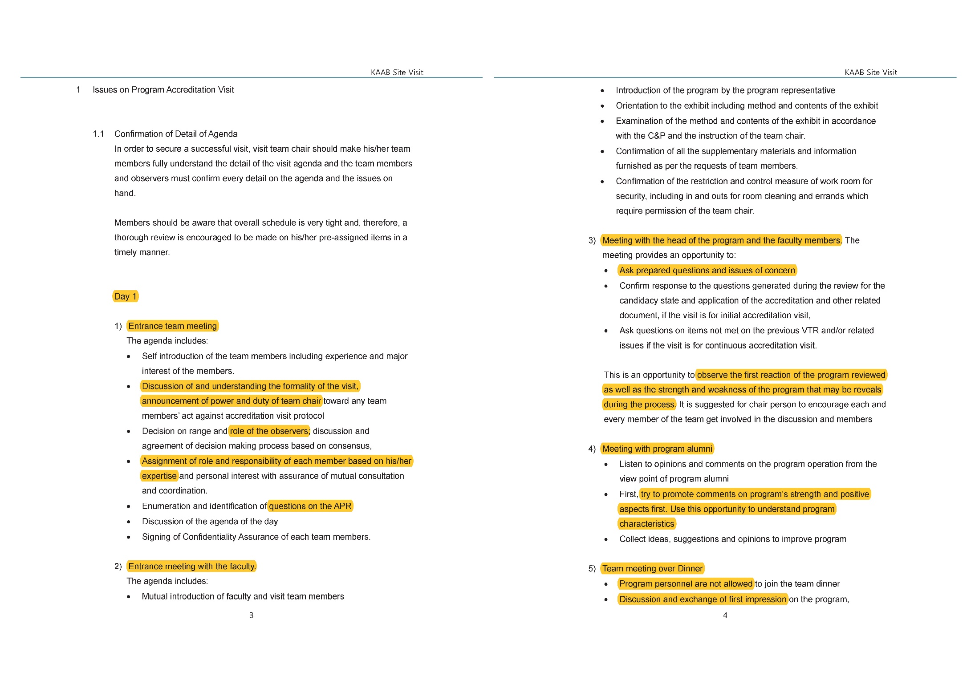
Site Visit Agenda
2018 Online Training 1/3
Site Visit Guideline

Slide 11
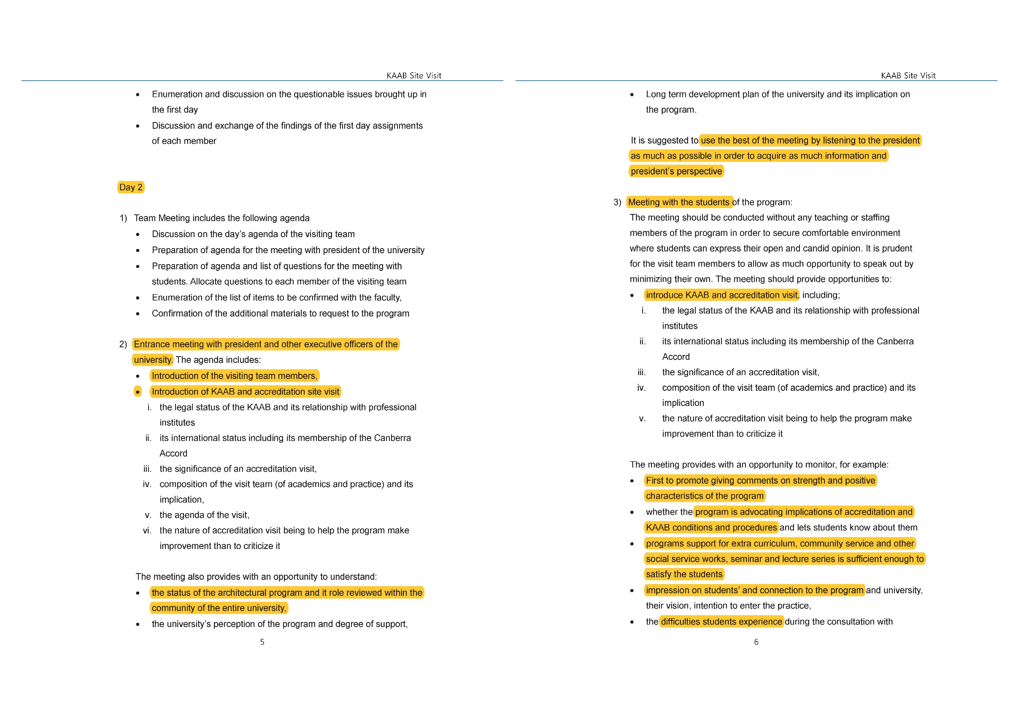
2018 Online Training 1/3

Slide 12
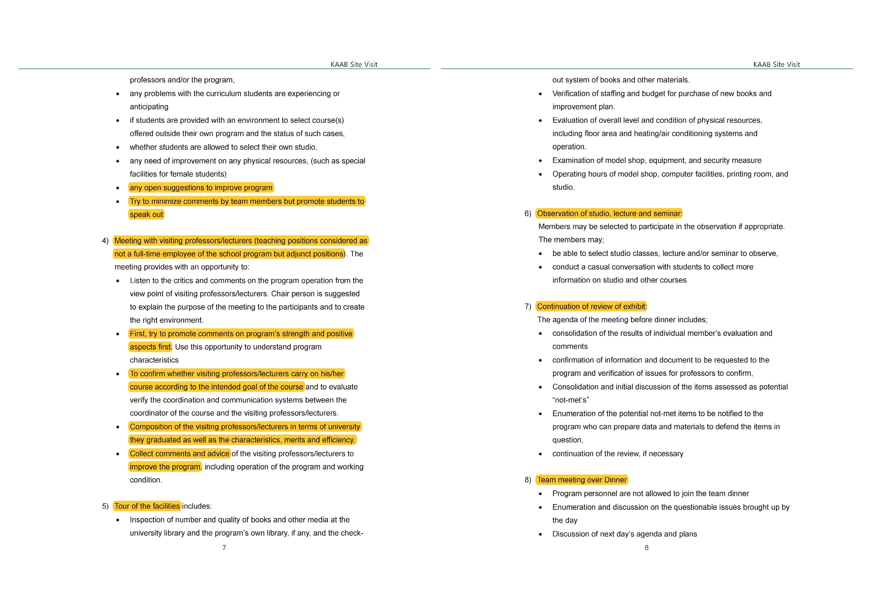
2018 Online Training 1/3

Slide 13
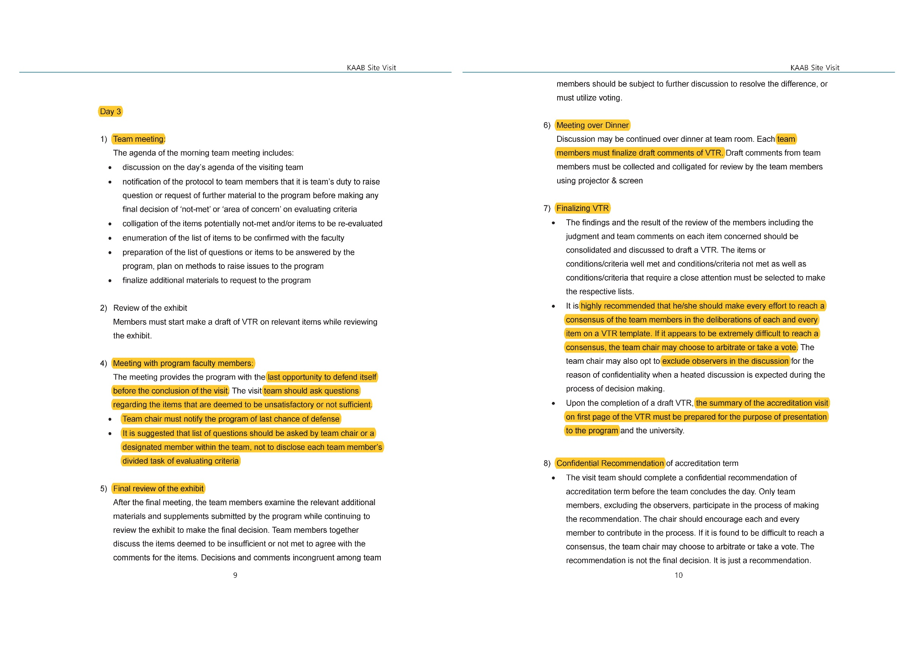
2018 Online Training 1/3

Slide 14
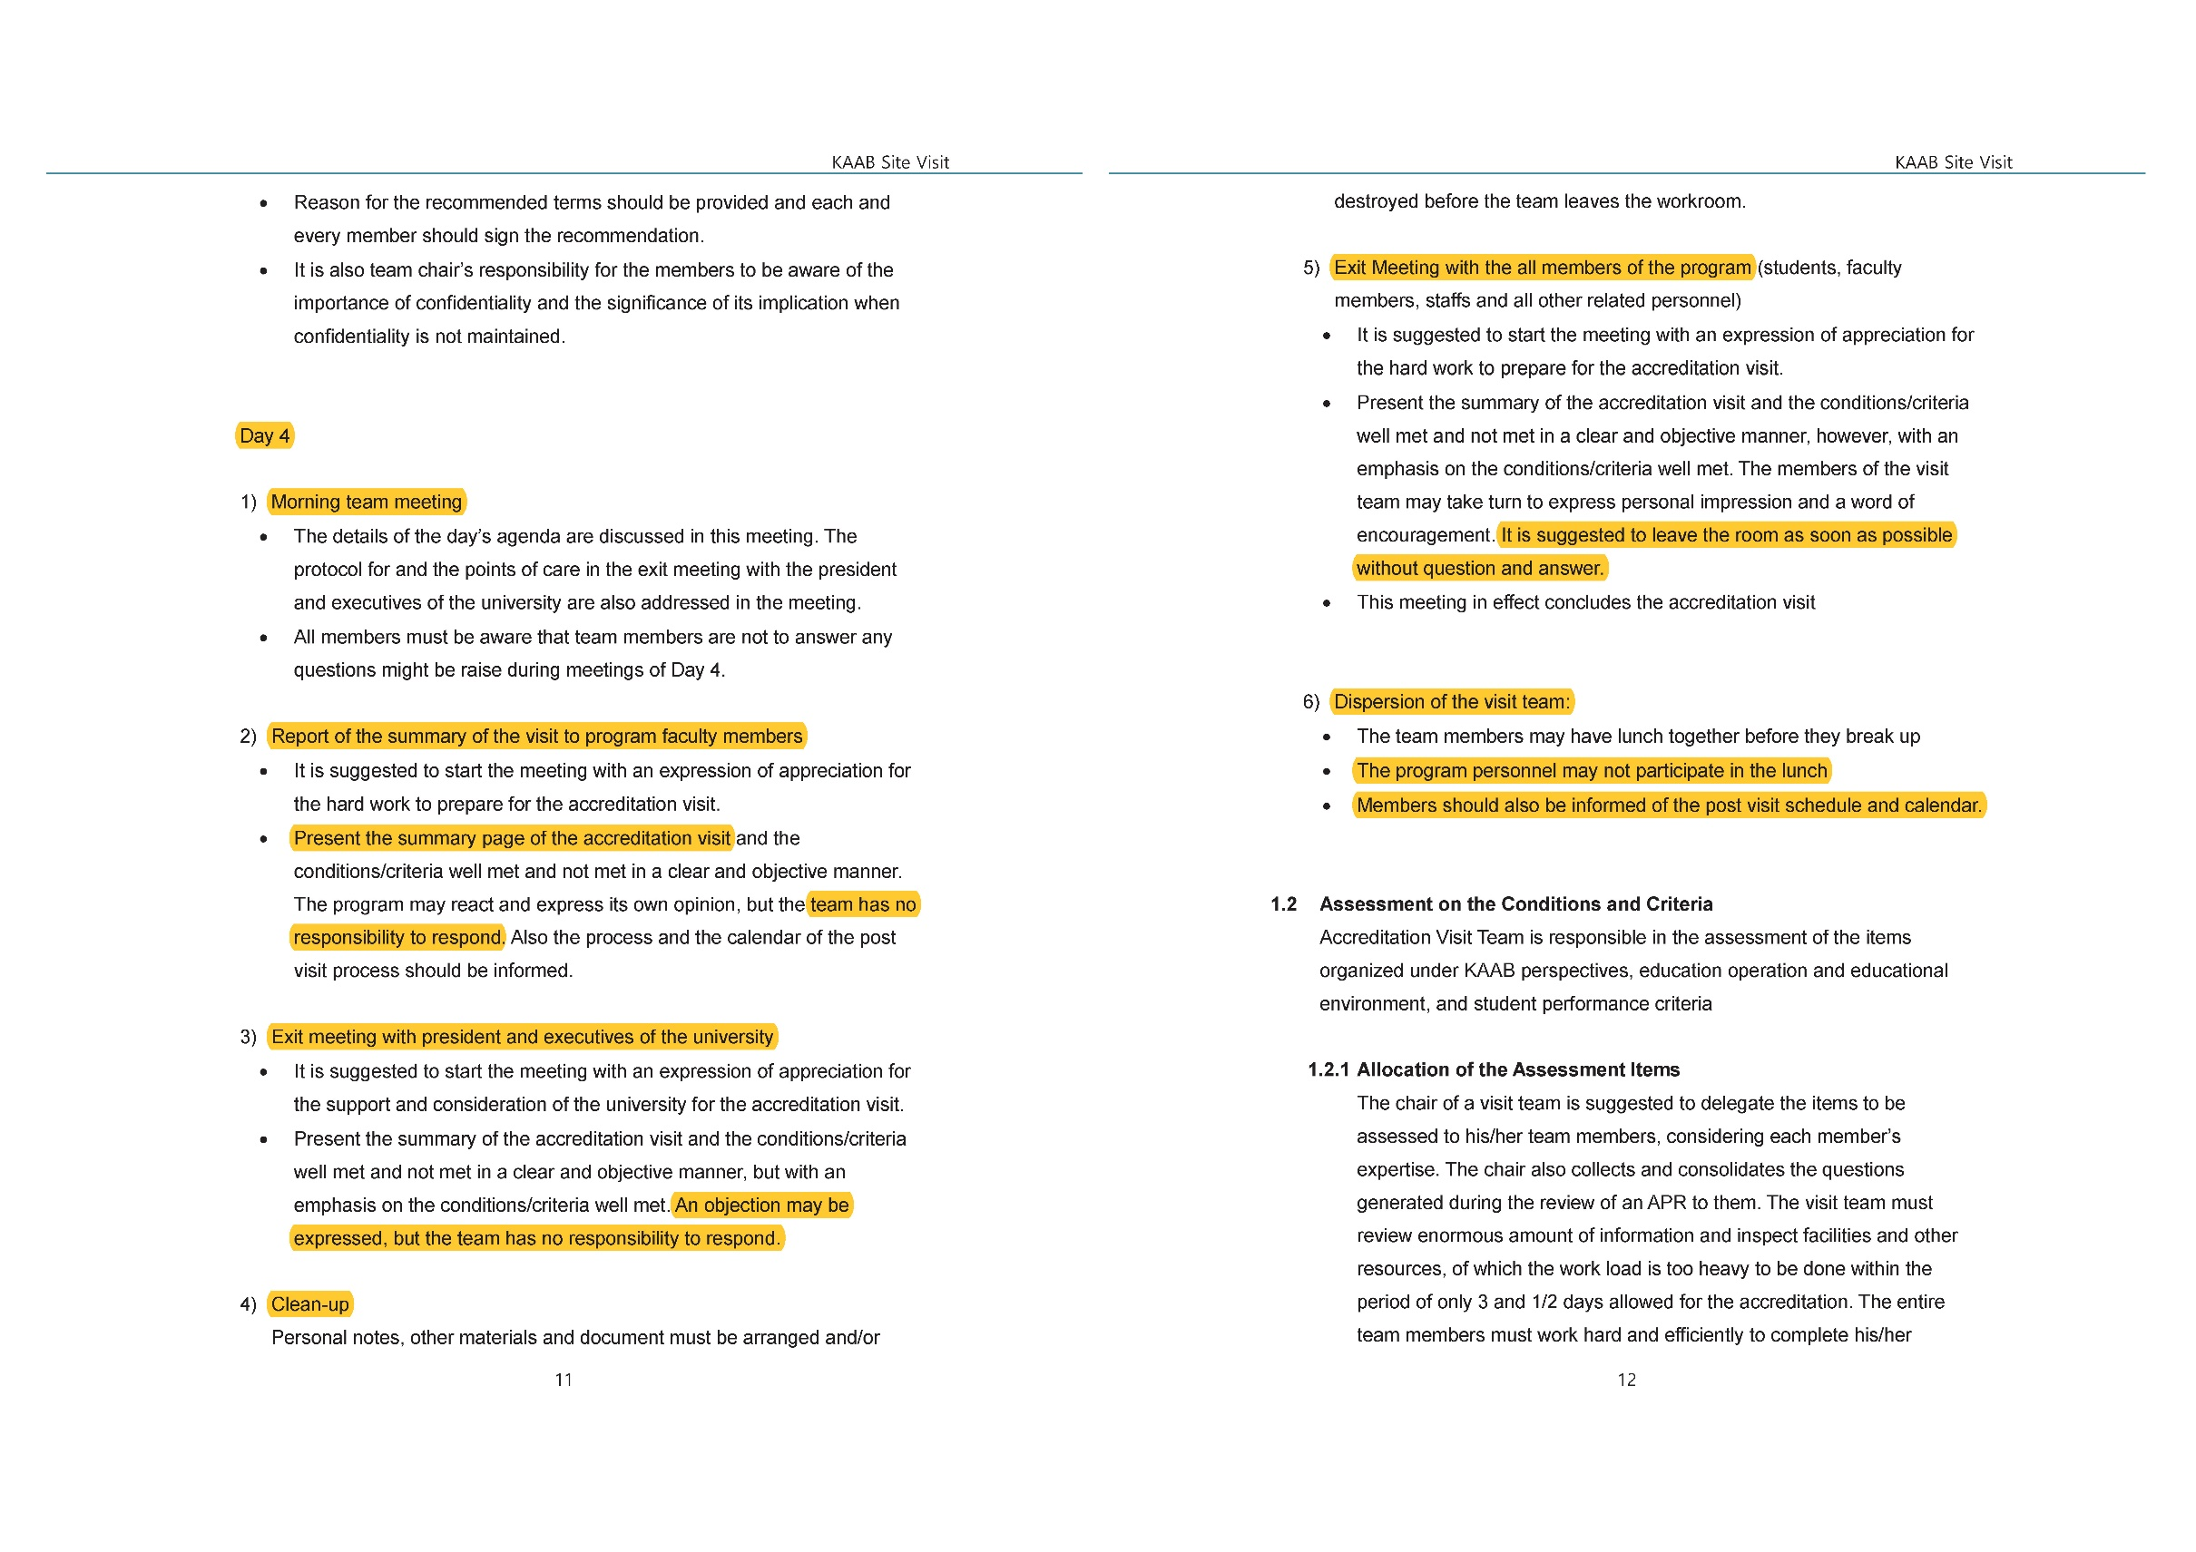
2018 Online Training 1/3

Slide 15
2018 Online Training 1/3
Overall Procedure of KAAB Accreditation
Site Visit Agenda
Site Visit Team’s Responsibilities & Protocols
Team Room Preparation
Conditions for Accreditation
Visiting Team Report
Confidential Recommendation
Evaluation of the Site Visit

Slide 16
2018 Online Training 1/3
Overall Procedure of KAAB Accreditation
Site Visit Agenda
Site Visit Team’s Responsibilities & Protocols
Team Room Preparation
Conditions for Accreditation
Visiting Team Report
Confidential Recommendation
Evaluation of the Site Visit

Slide 17
2018 Online Training 1/3
Site Visit Team’s Responsibilities & Protocols
Site visit of the KAAB is not a unilateral evaluation but a two-way peer evaluation carried on in collaboration with the program to be reviewed.
Visit team members must not be authoritative but maintain positive attitude to encourage communication with the program.
Key Characteristics of the KAAB Accreditation :
It is a social service that relies on active participation of voluntary visit members.
The programs being accredited are encouraged to actively participate in the assessment process and make every effort to persuade Visit Team members.
Not only the visit team, but the programs being accredited must be well prepared with a deep understanding of Conditions and Procedures, and in complete agreement with the contents.
The Conditions for accreditation is aimed for sufficient internship capabilities rather than an expected performance by a professional architect.

Slide 18
2018 Online Training 1/3
Site Visit Team’s Responsibilities & Protocols
Key to Remember :
Team members must be fully aware of the Conditions & Procedures of the KAAB.
All information and document obtained before, during, and after the Site Visit must kept strictly confidential.
All review must be based on team member’s own judgement, although it must be constantly reminded that all review opinions form a visit team’s collective review.
Team chair has responsibility of coordinating & approval of Team room preparation before the site visit start.
All team members are to use his or her own personal computer and supplies during the visit.
Team members must consider site visit as a volunteer to contribute for program’s further growth. Also reminded that all members’ conduct must represent the KAAB’s best interest.
Observers are not supposed to participate in final assessment process. The Team Chair has full right to dismiss observer at anytime during the visit if necessary.
If team member’s opinions divide, majority vote must be utilized.
It is important to provide chance to defend any questionable item by school program before making final assessment
It is important that all assessments must be made to complete within the period of site visit.

Slide 19
2018 Online Training 1/3
Site Visit Team’s Responsibilities & Protocols
Violation to the protocol may construe a serious procedural error and may defame the character of the KAAB.
Violation of the protocol may be reflected on the program’s assessment of the visit team.
Site Visit Protocol :
All team members must observe the Site Visit Guideline.
All the proceeding and information is confidential.
Responsibilities allocated to the team members must be kept disclosed.
Authoritative and/or unilateral attitude is prohibited.
Work as a team with no individual agenda.
A team member should not advance an advice or a suggestion as a solution to an assessed matter.
Emotional expressions or reactions must not be demonstrated.
Team members should not be bowed to dignity.

Slide 20
2018 Online Training 1/3
Site Visit Team’s Responsibilities & Protocols
Violation to the protocol may construe a serious procedural error and may defame the character of the KAAB.
Violation of the protocol may be reflected on the program’s assessment of the visit team.
Site Visit Protocol :
Personal phones must be turned off.
No picture should be taken during the visit.
No favor is requested to any program personnel.
No imploring for a job or no scouting for a person.
No gift or entertainment should be accepted.
No special favor even at the conclusion of the visit.
Cooperate with the team and the team chair.

Slide 21
2018 Online Training 1/3
Overall Procedure of KAAB Accreditation
Site Visit Agenda
Site Visit Team’s Responsibilities & Protocols
Team Room Preparation
Conditions for Accreditation
Visiting Team Report
Confidential Recommendation
Evaluation of the Site Visit

Slide 22
2018 Online Training 1/3
Overall Procedure of KAAB Accreditation
Site Visit Agenda
Site Visit Team’s Responsibilities & Protocols
Team Room Preparation
Conditions for Accreditation
Visiting Team Report
Confidential Recommendation
Evaluation of the Site Visit

Slide 23
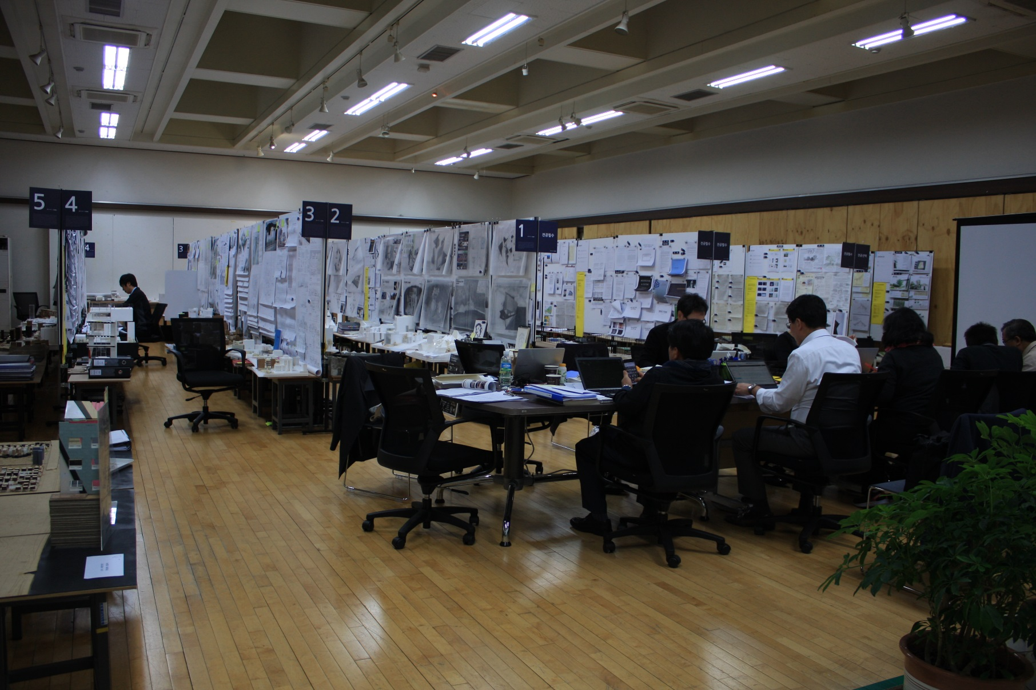
Team Room Preparation
2018 Online Training 1/3

Slide 24
Team Room Preparation
2018 Online Training 1/3
Creative and Effective ways of displaying curriculum and student work outcome rely on program’s own discretion
Meeting with the Conditions & Procedures
Effective
Methods
For
Displaying
Proof of Student Work Samples
“By Program’s Own Discretion”
Team Room
Display
Actual work samples from past school calendar year (two semester)
Team Room must be prepared within the program or near by
Visit agenda and CV’s of team members must be disclosed at Team Room

Slide 25
Team Room Preparation
2018 Online Training 1/3
Student Performance Criteria is comprised of following two levels of achievement levels.
Understanding: Students must acquire, comprehend, and be well acquainted with information. Students can correctly paraphrase or summarize information without necessarily relating it to other material or seeing its fullest implications.
Ability: Students must be capable of manipulating and relating specific information acquired to achieve tasks. Students should be able to select the correct information suitable to the given situation, and facilitate it to resolve the particular problems on hand.

Slide 26
Team Room Preparation
2018 Online Training 1/3
Following kinds of student work outcome could serve as evidence for ‘Ability’, and ‘Understanding’ achievement levels of Student Performance Criteria at the Team Room.
Student work outcome in format of (formats below must be specified in course syllabus) :
Term examinations and quiz’s answer sheets with questions
Term papers and reports bearing student’s work
Array of design studio work outcomes such as visual works, drawings, models and installations
Video footage showing student’s presentation of own work
All sampling of student works must be consisted of in groups of ‘high-pass’ and ‘low-pass’ student work samples.

Slide 27
Team Room Preparation
2018 Online Training 1/3
The “Team Room” must be a combined space for student works exhibition and team member’s conference
Before site visit, Team Chair must visit team room in advance and confirm with the program on the status of team room preparation
Secured for confidentiality. It is the team chair’s responsibility to manage security.
Furnished with a conference table large enough to accommodate all the team members and observers and chairs, preferably in the same space as the students’ class output and supporting materials and information.
Furnished with enough chairs to have a meeting with lecturers.
Equipped with a telephone, a desktop computer with Internet connection, a laser printer and copier, a beam projector and a screen, power outlets, and wired or wireless Internet service.
Office supplies and other miscellaneous supplies and fixtures may be furnished with a mutual agreement between the team chair and the program. No additional items are allowed in the team room other than the items listed above.

Slide 28
Team Room Preparation
2018 Online Training 1/3
Course Materials
It may be prudent to display the general electives and studio courses separately, but in a consistent manner and in such a way that the overall flow of the courses may be easily traced and cross-referenced.
All sampling of student works must be consisted of works of one academic year prior to the site visit, in groups of ‘high-pass’ and ‘low-pass’ student work samples.
Position of the course within the course matrix and cross-reference to students’ performance criteria
Course syllabus (refer to Appendix 5 of Guideline for Accreditation Visit)
Lecture notes, references and other distributed materials
Documents related to class attendance
Documents related to class evaluations by students
Videotapes or other digital media of students’ presentation
Documents related to student field trips with descriptions of purpose of the trips
Grading scores of the course displayed and distribution of the scores

Slide 29
Team Room Preparation
2018 Online Training 1/3
Student Work Outcome
The output of the students’ work must include course materials, quiz, test, and the related final output of the students’ work.
Textbooks, references, lecture notes and other related course materials.
Educational field trips with statement of purpose and schedules stipulated in the course syllabus.
Adequate number of student work samples in relation to the size of the display space, number of courses to be displayed, and importance of material.
Works in display must be the original copy.
Sampling of ‘high-pass’ works must be pinned up using vertical surface, and ‘low-pass’ works must be stored within the team room or easily accessible area.
Grades must be shown on each of student works with indication of grade distribution of each of student works
All student work outcome of past accreditation term period must be stored and accessible in digital format

Slide 30
Team Room Preparation
2018 Online Training 1/3
General Cautions for Lecture Courses in Display
Tests, quizzes, answer sheets and reports must be sampled for display to represent groups of high and low scores. The rest must be stored safely and available at the request of the visiting team.
Design Presentation materials must be original copies. If it is not possible to print out hard copies, presentation by means of digital equipment may be acceptable with the prior agreement of the team chair.
In case of group work, credits for each contributor must be clearly marked.
All student work output since the last accreditation visit must be stored in either real copies or in digital form. Digital image files must have an adequate level of resolution in either .jpg or .pdf files. A computer that can show the images must be furnished in the team room.
Sampling of ‘high-pass’ works must be pinned up using vertical surface, and ‘low-pass’ works must be stored within the team room or easily accessible area.

Slide 31
Team Room Preparation
2018 Online Training 1/3
General Cautions for Design Studio Courses in Display
Only the drawings and models originally made for class presentation can be displayed for the accreditation visit.
It is prohibited to re-work or reproduce for the sake of the accreditation visit.
In case of group work, credits for each contributor must be clearly marked.
If a studio class was divided into separate groups to work on a project with the same goal and contents in the same academic year, the program may use its discretion to select the outputs for the sake of efficient and meaningful display.
Contents and the extents of the display should be discussed with the visiting team chair, and it is recommended to furnish the process of students’ design works (student portfolio) not limited to end result. It is suggested that the team room not be crowded with too much student works in display.
All student work output since the last accreditation visit must be stored in either real copies or in digital form. Digital image files must have an adequate level of resolution in either .jpg or .pdf files. A computer that can show the images must be furnished in the team room.
Sampling of ‘high-pass’ works must be pinned up using vertical surface, and ‘low-pass’ works must be stored within the team room or easily accessible area.

Slide 32
2018 Online Training 1/3
Faculty Member Work Display
Purpose of displaying faculty member’s work?
To help visiting team members get acquainted with the faculty members’ achievements.
Caution :
Avoid excessive display of works
Works in display should be within past 3 years of works
Utilize existing actual works and samples, avoid producing new display materials

Slide 33
2018 Online Training 1/3
Overall Procedure of KAAB Accreditation
Site Visit Agenda
Site Visit Team’s Responsibilities & Protocols
Team Room Preparation
Conditions for Accreditation
Visiting Team Report
Confidential Recommendation
Evaluation of the Site Visit

Slide 34
Conditions for Accreditation
2018 Online Training 1/3
Evaluating Criteria of Visiting Team Report
2018 KAAB Conditions
2.1 KAAB Perspectives on Architectural Education 4 Criteria
(1) Architectural Education and the Institution
(2) Architecture Education and the Students
(3) Architecture Education and the Architect
(4) Architecture Education and Society
2.2 Self Assessment System of Professional Degree Program 7 Criteria
2.3 Degree and Curriculum
2.4 Student Information
2.5 Human Resources and Operating System
2.6 Physical and Information Resources
2.7 Financial Resources
2.8 Research Development
2.9 Student Performance Criteria 26 Criteria
Total of 37 Criteria

Slide 35
Conditions for Accreditation
2018 Online Training 1/3
2.1 KAAB Perspectives on Architectural Education
2.1.1 Architectural Education and the Institution
“From School’s point of view”
2.1.2 Architecture Education and the Students
“From Students’ point of view”
2.1.3 Architecture Education and the Architect
“From Architects’ point of view”
2.1.4 Architecture Education and Society
“From General Public’s point of view”

Slide 36
Conditions for Accreditation
2018 Online Training 1/3
2.2 Self Assessment System of Professional Degree Program
2.3 Degree and Curriculum
2.4 Student Information
2.5 Human Resources and Operating System
2.6 Physical and Information Resources
2.7 Financial Resources
2.8 Research Development

Slide 37
Conditions for Accreditation
2018 Online Training 1/3
2.2 Self Assessment System of Professional Degree Program
Professional Program must maintain a self-assessment system and mid to long-term strategic plan to attain educational objectives and continue to improve
It must include composition of faculty members and student recruiting plan, survey, and reflection of opinions of graduates
A mere class evaluation alone is not sufficient to assess the overall achievement of the program objectives
Description of the program’s self-assessment procedure to pursue educational objectives
Systematic and periodic means of collecting and utilizing opinions of faculty members, students, adjunct faculties, graduates and other 3rd party members to improve the program
Appropriate analysis and evident of application for improvements from class evaluation materials for core classes
Mid to long-term strategic plans for continuing improvement
Analysis between self-assessment outcome and earlier strategic plans

Slide 38
Conditions for Accreditation
2018 Online Training 1/3
2.3 Degree and Curriculum
Curriculums must be arranged in such a way that graduates of the program have the ability to think critically and compete successfully in the context of fast-changing society
The program’s quality should not be compromised by any incoming transfer student by program’s systematic arrangements
Design studios must allow settings for one to one interactive tutorial format, and the total teaching credit hours for design studios must be minimum of 30% of total credit hours required for the degree.
Degree conferred and description of the degree
Description on the frame of curriculums including liberal arts subjects, mandatory/elective subjects
Matrix to demonstrate a systematic structure for completion of course works toward the professional degree and management system of academic record of each individual student
A system of monitoring each student’s curriculum
Curriculum objectives for each academic year and different levels of students
Description of each studio class and lecture class, as well as the relationship between the classes

Slide 39
Conditions for Accreditation
2018 Online Training 1/3
2.4 Student Information
The program must admit qualified students and provide them with every opportunity to learn in a rich, educational environment.
Means and criteria of admitting incoming transfer students in accordance with program characteristic or educational goal
For master degree program, additional information of educational content for incoming transfer students’ past bachelor’s degree level, amount and kinds of admitted course credits
Statistics on the quota of students, number of registrations, number of transfer students by class or academic year, semester, and overall number
Number of students who passed and failed, and the ratio of pass to fail, by class or academic year and overall number
The ratio of faculty to number of students, and basic data for ratio calculation
Distribution of leaflets or booklets to introduce the accreditation system for professional degree programs for perspective students and parents
Proof that the program provided students with opportunities for field trips and group activities in and out of school

Slide 40
Conditions for Accreditation
2018 Online Training 1/3
2.6 Physical and Information Resources
Professional degree programs must have appropriate physical and information resources to support efficient architectural education.
Space appropriate for one to one tutorial setting, promoting interactive design studio education
Space appropriate for design presentation, review, display of works, and group discussion
Space and facilities appropriate for information technology courses and printing needs
Space and facilities appropriate for modeling exercises
Status of available information technology resources, other equipments exclusive to the program
Status of information resources including means of consistent updates and management
Status of other physical resources equipped for the program

Slide 41
Conditions for Accreditation
2018 Online Training 1/3
2.7 Financial Resources
Professional degree programs must disclose information on the financial statement, as well as financial support given by the institution to other comparable programs within the same institution.
Program budget, endowments, scholarships and other related items
Annual expenditures per undergraduate and graduate architecture student, compared to the students of the other comparable programs in the institution

Slide 42
Conditions for Accreditation
2018 Online Training 1/3
2.8 Research Development
The program must describe the academic and faculty research activities that enhance the quality of education in support of the mission of the program and demonstrate the achievements of the activities.
List of research projects and respective grants
Demonstration of the relationship between the research / design projects and courses offered for the program in support of the program mission and curriculum

Slide 43
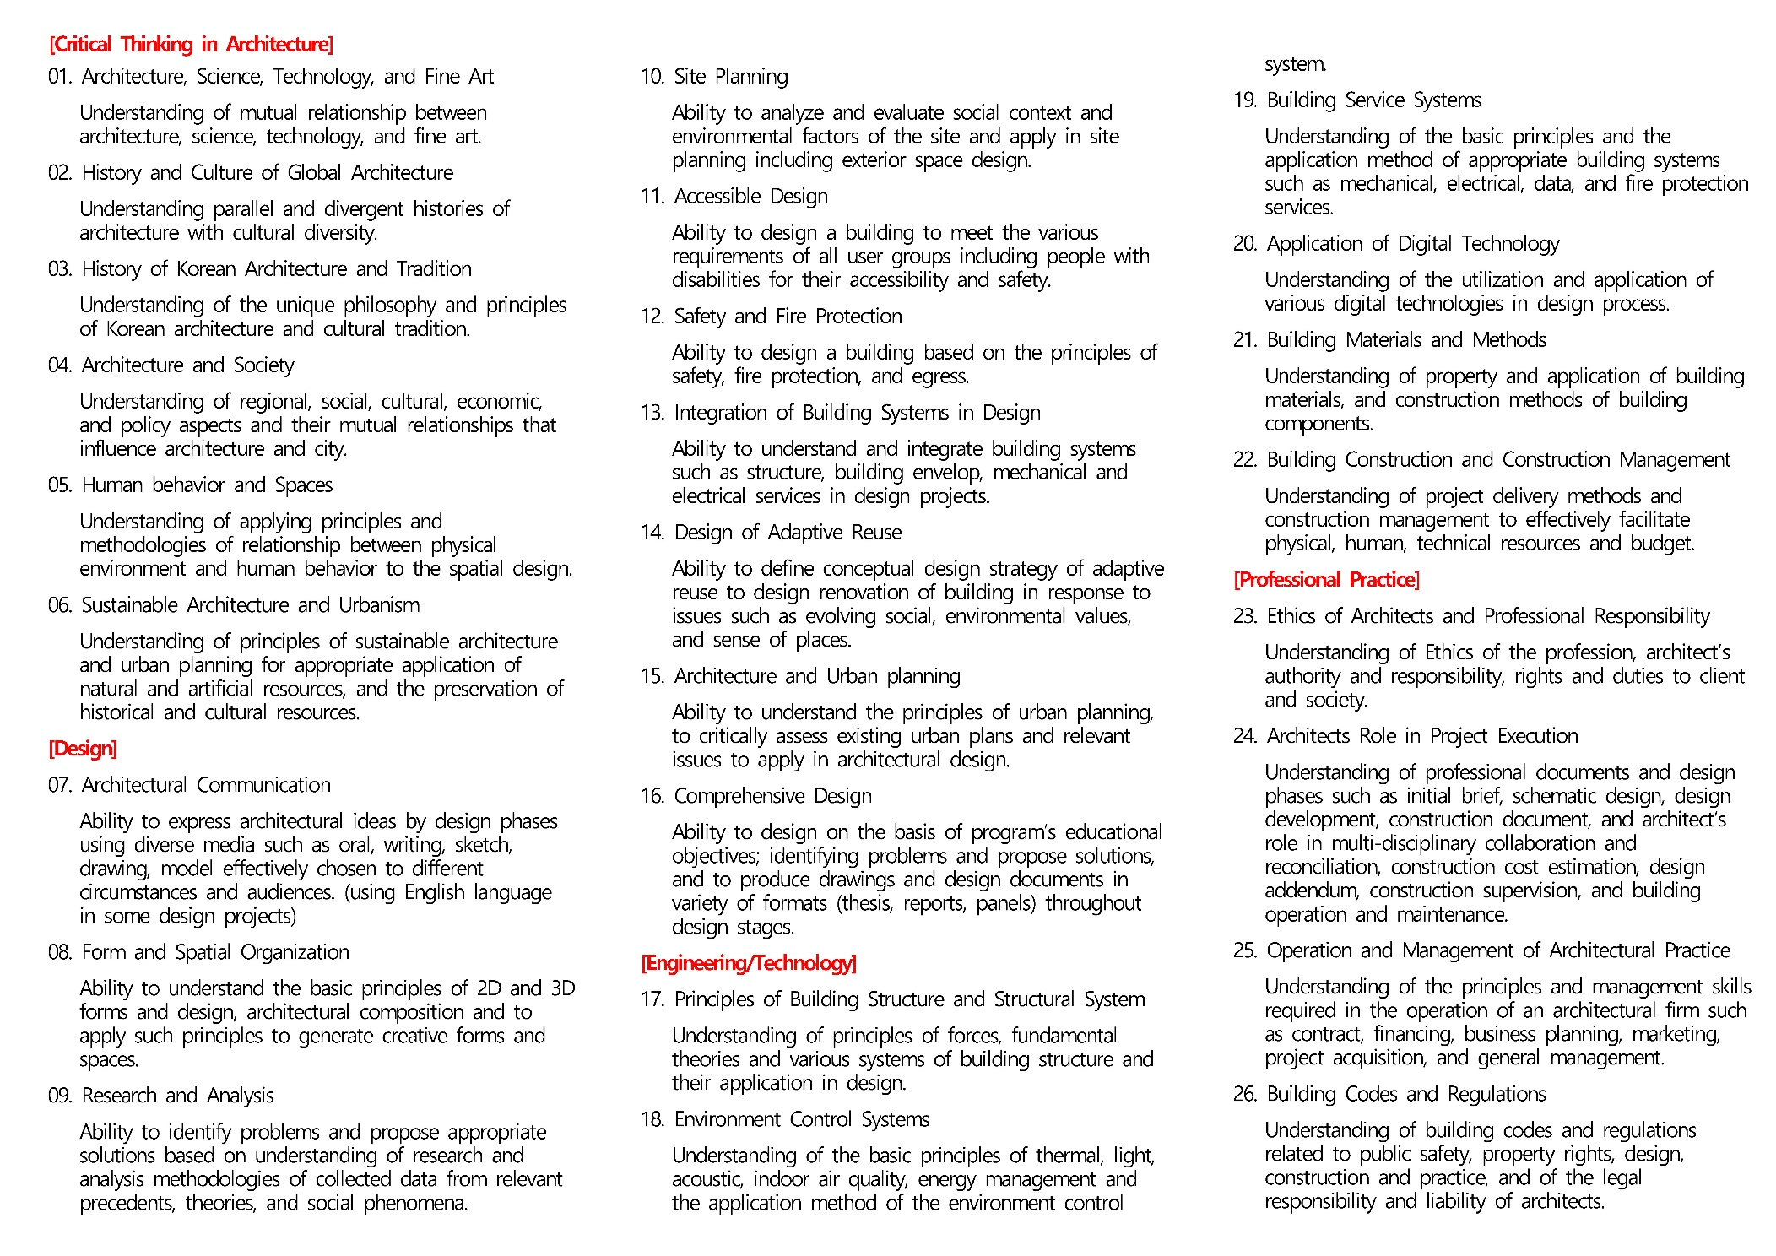
Conditions for Accreditation
2018 Online Training 1/3
2.9 Student Performance Criteria (2018 version)

Slide 44
KAAB Site Visit Team Online Training
2018 Online Training 1/3
Overview of Accreditation Process
KAAB Conditions & Procedure
Member of Canberra Accord

