Slide 1





KAAB Site Visit Team Online Training
2018 Online Training 2/3
Visiting Team Report
Member of Canberra Accord

Slide 2
2018 Online Training 2/3
KAAB Site Visit Team Online Training
Overall Procedure of KAAB Accreditation
Site Visit Agenda
Site Visit Team’s Responsibilities & Protocols
Team Room Preparation
Conditions for Accreditation
Visiting Team Report
Confidential Recommendation
Evaluation of the Site Visit

Slide 3
Visiting Team Report
2018 Online Training 2/3
Evaluating Criteria of Visiting Team Report
2018 KAAB Conditions
2.1 KAAB Perspectives on Architectural Education 4 Criteria
(1) Architectural Education and the Institution
(2) Architecture Education and the Students
(3) Architecture Education and the Architect
(4) Architecture Education and Society
2.2 Self Assessment System of Professional Degree Program 7 Criteria
2.3 Degree and Curriculum
2.4 Student Information
2.5 Human Resources and Operating System
2.6 Physical and Information Resources
2.7 Financial Resources
2.8 Research Development
2.9 Student Performance Criteria 26 Criteria
Total of 37 Criteria

Slide 4
2018 Online Training 2/3
Visiting Team Report
Assessment Process
Assessment of each item according to conditions and procedures should be made not based on individual’s assertion or opinion, but agreement and consensus of the team members. Members should present his findings to share with the other members, and the chair should create an environment in which all the members can fully discuss on the issues on hand in freely to draw a fair and justified conclusion. In case there is a disagreement among the members, members should present an objective and precise reasoning to support his/her assertion and/or persuade the other member to reach an agreement and/or a consensus. When an issue cannot be resolved and fell into a dead lock situation despite of the team chair’s arbitration, the team chair may choose to put the issue on a vote.
The program being reviewed should be provided sufficient opportunity to defend itself and to present additional material or document to justify its own claim during the whole process of the accreditation visit.
The program being reviewed, on the other hand, should respond actively in a positive way because it is impossible for the program to reconfirm or correct the result once the accreditation visit is concluded. It is not allowed to appeal the decisions on the assessment of individual items.

Slide 5
2018 Online Training 2/3
Visiting Team Report
Determination of ’Met’ or ‘Not Met’
Each individual items on the VTR is assessed by either ‘Met’ or ‘Not Met’. There is no provision of rules and/or standards based on which decisions can be made. Decisions are made purely by review/assessment of the exhibit, document and information provided by the program as well as team members’ judgment and discretion. The visit team, therefore, should make a fair and justified decision according to the assessment procedure.
Since most of the items are rather complicated and the decision process of these items has to rely on the team members’ subjective judgment, however, it is strongly suggested to make a final decision based on consensus. The team must make its best judgment by taking into account the period of the item being unsatisfactory, how the program has responded to improve and the result it achieved.
The team must make best decision based on wholesome judgement over all criteria, degree of impact a certain item will influence to the overall quality of the program, and for the best interest for the students.

Slide 6
2018 Online Training 2/3
Visiting Team Report
Assessment of Visiting Team by School Program & Appeals
The program being reviewed will also observe and assess the visit team and its performance by submitting evaluation of the visiting team forms after the visit. The team chair must lead the visit process strictly according to pre-agreed agenda. Failure to do so may lead the program to file an appeal process afterward due to failure to follow the agreed procedure. With factual errors on VTR, they are the grounds for the program to raise an appeal after the site visit.
‘Meeting accreditation criteria is to achieve knowledge and skill levels ready for sound professional internship, not to possess that of an professional architect.’

Slide 7
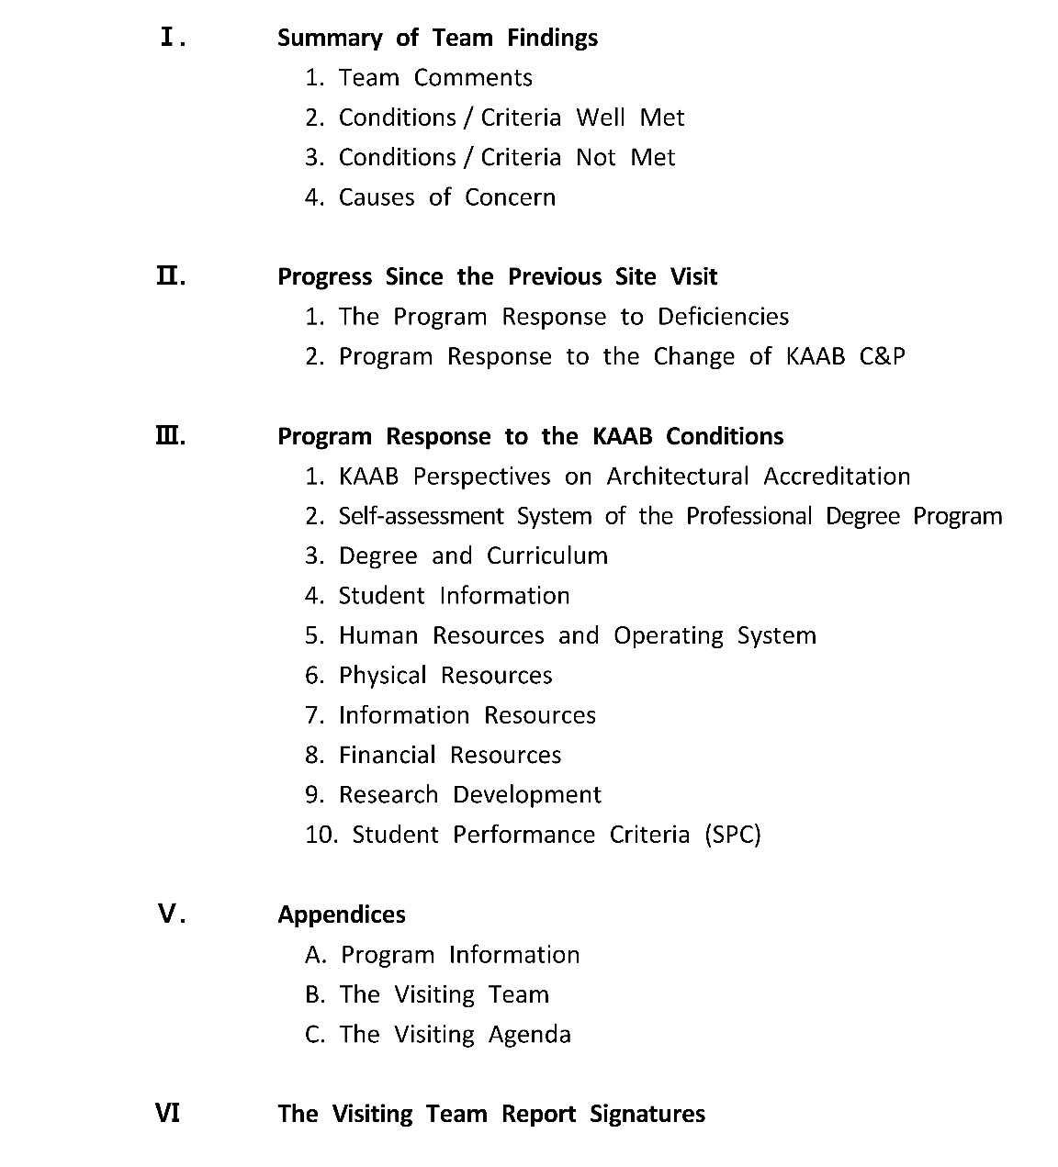
2018 Online Training 2/3
Visiting Team Report
Contents of the Visiting Team Report
Total of 37 Criteria

Slide 8
2018 Online Training 2/3
Visiting Team Report
Contents of the Visiting Team Report
Main purpose of the ‘Team Comments’ is to list overall review outcome and comment for the program by the team
Recommended to offer sign of appreciation for site visit preparation by the program
Start by listing positive strength of the program, identifying the school program’s expected role for the local professional community, historic value and legacy of the school program
Team’s overall comment must be intended for strengthening and further improvement of already identified positive aspect of the program, and list areas deserving improvement and immediate attention

Slide 9
2018 Online Training 2/3
Visiting Team Report
Contents of the Visiting Team Report
‘Criteria Well Met’ items must be selected after a careful review of the overall achievement, considering the program’s goals and identified characteristics
It could be used to appraisal of already identified program’s strength and positive characteristics, distinguished from simple ‘Met’ criteria

Slide 10
2018 Online Training 2/3
Visiting Team Report
Contents of the Visiting Team Report
‘Criteria Not Met’ items must be selected after a careful review of the overall outcome of the review, considering areas in need of immediate attention by the program
All listings must accompany with clear description of grounds or reasons for such decision
Before listing as ‘Not Met’, the team must have given program sufficient chance to respond properly, with supplemental materials (if necessary)

Slide 11
2018 Online Training 2/3
Visiting Team Report
Contents of the Visiting Team Report
Criteria of ‘Causes of Concern’ items are among ‘Met’ criteria, but criteria prone to become ‘Not Met’ if sufficient attention is not given
For best interest of the student and the program, they are selected to program to pay immediate attention
All listings must accompany with clear description of grounds or reasons for such decision
Before listing as ‘Causes of Concern’, the team must give program sufficient chance to respond properly

Slide 12
2018 Online Training 2/3
Visiting Team Report
Contents of the Visiting Team Report
Initial Accreditation
Program
Program responses for concerned areas identified at Candidacy Application and Site Visit Application
Site Visit Team
Program responses reviewed at Site Visit
Accreditation Committee
Oversees program responses, visit team recommendations

Slide 13
2018 Online Training 2/3
Visiting Team Report
III. Program Response to the KAAB Conditions
2.1 KAAB Perspectives on Architectural Education
2.1.1 Architectural Education and the Institution
“From School’s point of view”
2.1.2 Architecture Education and the Students
“From Students’ point of view”
2.1.3 Architecture Education and the Architect
“From Architects’ point of view”
2.1.4 Architecture Education and Society
“From General Public’s point of view”
Met | Not Met
? | ?

Slide 14
2018 Online Training 2/3
Visiting Team Report
III. Program Response to the KAAB Conditions
2.1 KAAB Perspectives on Architectural Education
2.1.1 Architectural Education and the Institution
“From School’s point of view”
2.1.2 Architecture Education and the Students
“From Students’ point of view”
2.1.3 Architecture Education and the Architect
“From Architects’ point of view”
2.1.4 Architecture Education and Society
“From General Public’s point of view”
Met | Not Met
? | ?

Slide 15
2018 Online Training 2/3
Visiting Team Report
III. Program Response to the KAAB Conditions
2.2 Self Assessment System of Professional Degree Program
2.3 Degree and Curriculum
2.4 Student Information
2.5 Human Resources and Operating System
2.6 Physical and Information Resources
2.7 Financial Resources
2.8 Research Development
Met | Not Met
? | ?

Slide 16
2018 Online Training 2/3
Visiting Team Report
III. Program Response to the KAAB Conditions
2.2 Self Assessment System of Professional Degree Program
2.3 Degree and Curriculum
2.4 Student Information
2.5 Human Resources and Operating System
2.6 Physical and Information Resources
2.7 Financial Resources
2.8 Research Development
Met | Not Met
? | ?

Slide 17
2018 Online Training 2/3
Visiting Team Report
III. Program Response to the KAAB Conditions
2.2 Self Assessment System of Professional Degree Program
2.3 Degree and Curriculum
2.4 Student Information
2.5 Human Resources and Operating System
2.6 Physical and Information Resources
2.7 Financial Resources
2.8 Research Development
Met | Not Met
? | ?

Slide 18
2018 Online Training 2/3
Visiting Team Report
III. Program Response to the KAAB Conditions
2.2 Self Assessment System of Professional Degree Program
2.3 Degree and Curriculum
2.4 Student Information
2.5 Human Resources and Operating System
2.6 Physical and Information Resources
2.7 Financial Resources
2.8 Research Development
Met | Not Met
? | ?

Slide 19
2018 Online Training 2/3
Visiting Team Report
III. Program Response to the KAAB Conditions
2.2 Self Assessment System of Professional Degree Program
2.3 Degree and Curriculum
2.4 Student Information
2.5 Human Resources and Operating System
2.6 Physical and Information Resources
2.7 Financial Resources
2.8 Research Development
Met | Not Met
? | ?

Slide 20
2018 Online Training 2/3
Visiting Team Report
III. Program Response to the KAAB Conditions
2.2 Self Assessment System of Professional Degree Program
2.3 Degree and Curriculum
2.4 Student Information
2.5 Human Resources and Operating System
2.6 Physical and Information Resources
2.7 Financial Resources
2.8 Research Development
Met | Not Met
? | ?

Slide 21
2018 Online Training 2/3
Visiting Team Report
III. Program Response to the KAAB Conditions
2.2 Self Assessment System of Professional Degree Program
2.3 Degree and Curriculum
2.4 Student Information
2.5 Human Resources and Operating System
2.6 Physical and Information Resources
2.7 Financial Resources
2.8 Research Development
Met | Not Met
? | ?

Slide 22
2018 Online Training 2/3
Visiting Team Report
III. Program Response to the KAAB Conditions
2.2 Self Assessment System of Professional Degree Program
Example of Comment
The team has not found enough evidence of periodic analysis and assessments for educational achievement. Instead of relying solely on internal members, the program is required to possess self-assessing tools which include 3rd party voices from such as students and alumni. Also, it is evident that lack of tangible short-, mid-, and long-term strategic plans for the program contributes to incompleteness of the Self Assessment System.
Met | Not Met
 | √

Slide 23
2018 Online Training 2/3
Visiting Team Report
III. Program Response to the KAAB Conditions
2.3 Degree and Curriculum
Example of Comment
Curriculum objectives for each academic year and different levels of students are not sufficiently stated in the APR.
The program’s nomenclature of the professional degree program is not distinguished from non-professional degree of similar level. Even though it would be difficult to override the government policy, the program’s appropriate effort for resolving this matter is urgently needed for the benefit of the program students and graduates.
Met | Not Met
 | √

Slide 24
2018 Online Training 2/3
Visiting Team Report
III. Program Response to the KAAB Conditions
2.3 Degree and Curriculum
Example of Comment
Curriculum objectives for each academic year and different levels of students are not sufficiently stated in the APR.
The program’s nomenclature of the professional degree program is not distinguished from non-professional degree of similar level. Even though it would be difficult to override the government policy, the program’s appropriate effort for resolving this matter is urgently needed for the benefit of the program students and graduates.
Met | Not Met
 | √

Slide 25
2018 Online Training 2/3
Visiting Team Report
III. Program Response to the KAAB Conditions
2.6 Physical and Information Resources
Example of Comment
Absence of equipment maintenance may affect student performance. Pin-up, critique spaces and sufficient exhibition area will enhance the quality of the design education.
Met | Not Met
 | √

Slide 26
2018 Online Training 2/3
Visiting Team Report
III. Program Response to the KAAB Conditions
2.9 Student Performance Criteria
02. Various Means of Expression
Ability to express architectural ideas appropriately by means of various media such as sketch, model, drawing, writing, and digital drawing.
Example of Comment
Even though students' ability to express their ideas through digital drawings is excellent, the program needs more attention to encourage students to use physical models to explore their ideas throughout the design studio.
Met | Not Met
 | √

Slide 27
2018 Online Training 2/3
Visiting Team Report
III. Program Response to the KAAB Conditions
2.9 Student Performance Criteria
04. World History of Architecture and Tradition
Understanding of architectural history of the world and the diversity of tradition.
Example of Comment
The team found insufficient amount of education by the current evidence and study courses presented by the program. Under the current format of education, it is viable that the study area of world history of architecture can be misled as superficial, fragmentary knowledge.
Met | Not Met
 | √

Slide 28
2018 Online Training 2/3
Visiting Team Report
III. Program Response to the KAAB Conditions
2.9 Student Performance Criteria
04. World History of Architecture and Tradition
Understanding of architectural history of the world and the diversity of tradition.
Example of Comment
Only one class covering broad range of architectural history does not provide students sufficient education for theory and history of world architecture.
Met | Not Met
 | √

Slide 29
2018 Online Training 2/3
Visiting Team Report
III. Program Response to the KAAB Conditions
2.9 Student Performance Criteria
09. Form and Space Organization
Understanding of the basic principles of 2D and 3D forms and design, architectural composition and ability to apply these principles to design a building.
Example of Comment
The design education in between Architectural Design Studio x to xx, and xxx to xxxx displays weak links. The work of xx does not display sufficient formal, conceptual study in obtaining its resulting architectural forms. The xxxx does not display sufficient process of conceptual formal studies to drawn results.
Met | Not Met
 | √

Slide 30
2018 Online Training 2/3
Visiting Team Report
III. Program Response to the KAAB Conditions
2.9 Student Performance Criteria
13. Barrier Free Design
Ability of design a building to meet the various requirement of diverse building users including elderly, the infirm, and handicapped/disability.
Example of Comment
The Architectural Design Studio works pertaining to this criterion does not display sufficient evidence. All individual student works in the intended studio must display sufficient study outcome.
Met | Not Met
 | √

Slide 31
2018 Online Training 2/3
Visiting Team Report
III. Program Response to the KAAB Conditions
2.9 Student Performance Criteria
14. Safety, Fire Protection and Emergency Egress
Ability to design a safe building based on the basic principles of building safety, fire protection and security and in consideration of safety of human life, evacuation, and/or emergency egress.
Example of Comment
Current evidence of student works at XX alone are not sufficient. Educational outcome is inconsistent among student works. Teaching materials and methods are not readily evident.
Met | Not Met
 | √

Slide 32
2018 Online Training 2/3
Visiting Team Report
III. Program Response to the KAAB Conditions
2.1 KAAB Perspectives on Architectural Education
2.1.3 Architecture Education and the Architect
Example of Comment
The program needs more attention to provide students with balanced opportunities to be exposed to diverse perspectives for architects.
(Causes of Concerns)
Met | Not Met
√

Slide 33
2018 Online Training 2/3
Visiting Team Report
III. Program Response to the KAAB Conditions
2.5 Human Resources and Operating System
Example of Comment
The workload of full-time lecturers causes concern, as some design studios such as lower level studios do not get enough individual tutorial time with lecturers. Although the co-teaching system of lecturer and assistant may enhance the level of practical drawings, the program requires to develop a strategy to utilize the assistant’s role upon different academic levels.
(Causes of Concerns)
Met | Not Met
√

Slide 34
2018 Online Training 2/3
Visiting Team Report
III. Program Response to the KAAB Conditions
2.9 Student Performance Criteria
25. Building Materials and Recycling
Understanding of the manufacturing process and application of building materials based on the basic knowledge on characteristics of materials, building components, traditional way of usage, material standards; as well as recyclability, maleficence, and other control measure of building materials.
Example of Comment
Student works currently presented do not prove a proper understanding of recyclability of materials, which has an important stance in the program’s mission ‘sustainable built environment’.
(Causes of Concerns)
Met | Not Met
√

Slide 35
2018 Online Training 2/3
Visiting Team Report
III. Program Response to the KAAB Conditions
2.9 Student Performance Criteria
30. Operation and Management of Architectural Practice
Understanding of the basic facts and management skills required in the operation of an architecture practice office.
Example of Comment
While program’s approach for off-campus is pioneering, the team is concerned of the quality control for students’ experience.
(Causes of Concerns)
Met | Not Met
√

Slide 36
2018 Online Training 2/3
Visiting Team Report
III. Program Response to the KAAB Conditions
2.8 Research Development
Example of Comment
XXX Architecture Program has a strong research tradition with XXX research groups. This will help students explore many possibilities and methodologies for their design solutions.
(Criteria Well Met)
Met | Not Met
√

Slide 37
2018 Online Training 2/3
Visiting Team Report
III. Program Response to the KAAB Conditions
2.9 Student Performance Criteria
15. Integration of Building Systems in Design
Understanding of a building system and its constituent elements such as building structure, building envelop, composition of building mechanical and electrical service and other building components, and the ability to integrate them into his/her design.
Example of Comment
The program has successfully conveyed the notion of integrated system design outcome to student body in general. Also this effort contributes positively to the reputation and characteristic known of the program.
(Criteria Well Met)
Met | Not Met
√

Slide 38
2018 Online Training 2/3
Visiting Team Report
III. Program Response to the KAAB Conditions
Difficult to judge?
Met | Not Met
? | ?
Display of student work outcome of giving exact text of ‘Criterion’ as homework problems or questions to solve at an examination.
For an example, “Describe ‘architecture and society’ in the aspects of regional, social, cultural, economic, and policy aspects and their mutual relationships that influence architecture and city. (Homework problem given to students are exact wordings of Student Performance Criteria #04, expecting students to find answers by themselves)
Consider following :
Generally, accreditation criteria must be taken as ‘minimum standard’ in education, not as a goal to achieve by its own. At first, it must be considered as a poor pedagogic practice.
Find course syllabus and teaching materials to confirm that enough of actual teachings on particular subjects are performed. If relevant materials are not evident enough, student’s work cannot be counted as learned outcome.
Student’s work outcomes seemed shallow and not enough teaching materials evident, particular criterion should be judged as Not Met or Causes of Concerns.

Slide 39
2018 Online Training 2/3
Visiting Team Report
Contents of the Visiting Team Report
Furnished by KAAB

Slide 40
2018 Online Training 2/3
Visiting Team Report
Contents of the Visiting Team Report
Signed by All Five Team Members

Slide 41
2018 Online Training 2/3
KAAB Site Visit Team Online Training
Overall Procedure of KAAB Accreditation
Site Visit Agenda
Site Visit Team’s Responsibilities & Protocols
Team Room Preparation
Conditions for Accreditation
Visiting Team Report
Confidential Recommendation
Evaluation of the Site Visit

Slide 42
2018 Online Training 2/3
KAAB Site Visit Team Online Training
Overall Procedure of KAAB Accreditation
Site Visit Agenda
Site Visit Team’s Responsibilities & Protocols
Team Room Preparation
Conditions for Accreditation
Visiting Team Report
Confidential Recommendation
Evaluation of the Site Visit

Slide 43
2018 Online Training 2/3
Confidential Recommendation
Term of Accreditation
Full Six-Year Term
Accreditation is valid for a full six (6) years following the year of the visit when unmet conditions are trivial and the program demonstrates a strong intention to correct the shortcomings.
Four-Year Term
Accreditation is valid for a Four (4) years following the year of the visit when considerable deficiency is found, but the program demonstrates a strong intention to correct the deficiency, and the Visit Team is fully convinced that the program has the capability to correct the deficiencies. If the program is awarded a four–year term consequently, the program is required to receive a full six-year term in the following accreditation. Otherwise, the program’s accreditation is terminated.
Conditional Three-Year Term
Accreditation is valid for three years following the year of the visit with conditions when considerable deficiency is found as in the case of the above four-year term, but the program fails to demonstrate a strong intention and means to correct the deficiency. The Visit Team stipulates the list of the items to be satisfactorily rectified by the time of the next visit. The accreditation to the program is terminated if the program fails to acquire either a four-year or a six-year accreditation in the next accreditation visit.

Slide 44
2018 Online Training 2/3
Confidential Recommendation
Term of Accreditation
Temporary Suspension of Accreditation
Temporary suspension of accreditation is awarded when an accreditation Visit Team is convinced that a program has failed to adequately prepare for an accreditation visit. In order to support its decision, the accreditation Visit Team must prepare and provide the program a list of deficiencies that must be rectified before the next visit. The accreditation visit may be rescheduled at a proper time in the future when the program is convinced that the deficiency has been rectified and the program is adequately prepared for an accreditation visit. The rescheduled accreditation visit must be made within one (1) year from the day the term is awarded.
Rejection/Revocation of Accreditation
The accreditation visit may be terminated and a rejection/revocation of accreditation may be awarded, when the Visit Team finds during the visit that condition(s)/criteria do not comply with the KAAB C&P, there exist irrevocable deficiencies, and/or when the program fails to submit its APR within the required period.
* Transitional Provision – please refer to Term of Accreditation of KAAB C&P

Slide 45
2018 Online Training 2/3
Confidential Recommendation
Term of Accreditation for Initial Accreditation
Full Five-Year Term
Certification is valid for five years. If the deficiencies are small and the intent is determined to rectify them, the program will be certified for five years.
Three-Year Term
Certification is valid for three years. If significant deficiencies are identified that could reduce the quality of the program, but the program is determined to correct them, the program will be certified for three years. For major deficiency that can result in three-year certification, refer to the Guidelines for Certification Evaluation.
Conditional Two-Year Term
Accreditation is valid for two years. If significant deficiencies in the reasons for the above three-year certification decisions are found and the program’s ability to address these deficiencies are unclear, the conditional statement will be given. At this time, the the visiting team specifies the conditions to be fulfilled before the visit in two years, and a two-year certification is granted. Refer to the Guidelines for Certification Evaluation for major deficiencies that can result in a conditional two-year certification.

Slide 46
2018 Online Training 2/3
Confidential Recommendation
Term of Accreditation for Initial Accreditation
Temporary Suspension of Accreditation
Temporary suspension of accreditation is awarded when an accreditation Visit Team is convinced that a program has failed to adequately prepare for an accreditation visit. In order to support its decision, the accreditation Visit Team must prepare and provide the program a list of deficiencies that must be rectified before the next visit. The accreditation visit may be rescheduled at a proper time in the future when the program is convinced that the deficiency has been rectified and the program is adequately prepared for an accreditation visit. The rescheduled accreditation visit must be made within one (1) year from the day the term is awarded.
Rejection of Accreditation
The accreditation visit may be terminated and a rejection of accreditation may be awarded, when the Visit Team finds during the visit that condition(s)/criteria do not comply with the KAAB C&P, there exist irrevocable deficiencies, and/or when the program fails to submit its APR within the required period. New application for accreditation may not be submitted within minimum of 2 years since last review.
* Transitional Provision – please refer to Term of Accreditation of KAAB C&P

Slide 47
2018 Online Training 2/3
Confidential Recommendation
1. Term of Accreditation
 | 6 Year | 4 Year | Conditional 3 Year | Suspension | Rejection
Term | □ | ■ | □ | □ | □
1. Term of Accreditation (for Initial Accreditation)
 | 5 Year | 3 Year | Conditional 2 Year | Suspension | Rejection
Term | □ | ■ | □ | □ | □

Slide 48
2018 Online Training 2/3
Confidential Recommendation
2. Grounds for Accreditation Term Recommendation
Example of Comment (A)
The five members of the visit team unanimously recommends a full accreditation of five-year term. Refer to the visit team report for details.
Example of Comment (B)
The Visiting Team was unanimous in the recommendation for a four year term of accreditation as per findings described in the Visiting Team Report and accordance to the KAAB Conditions & Procedures.

Slide 49
2018 Online Training 2/3
Confidential Recommendation
3. Signature by the Team Members
Representing AIK | NAME | Signature
Representing AIK | NAME | Signature
Representing AIK | NAME | Signature
Representing KIRA | NAME | Signature
Representing KIA | NAME | Signature

Slide 50
2018 Online Training 2/3
KAAB Site Visit Team Online Training
Overall Procedure of KAAB Accreditation
Site Visit Agenda
Site Visit Team’s Responsibilities & Protocols
Team Room Preparation
Conditions for Accreditation
Visiting Team Report
Confidential Recommendation
Evaluation of the Site Visit

Slide 51
2018 Online Training 2/3
KAAB Site Visit Team Online Training
Overall Procedure of KAAB Accreditation
Site Visit Agenda
Site Visit Team’s Responsibilities & Protocols
Team Room Preparation
Conditions for Accreditation
Visiting Team Report
Confidential Recommendation
Evaluation of the Site Visit

Slide 52
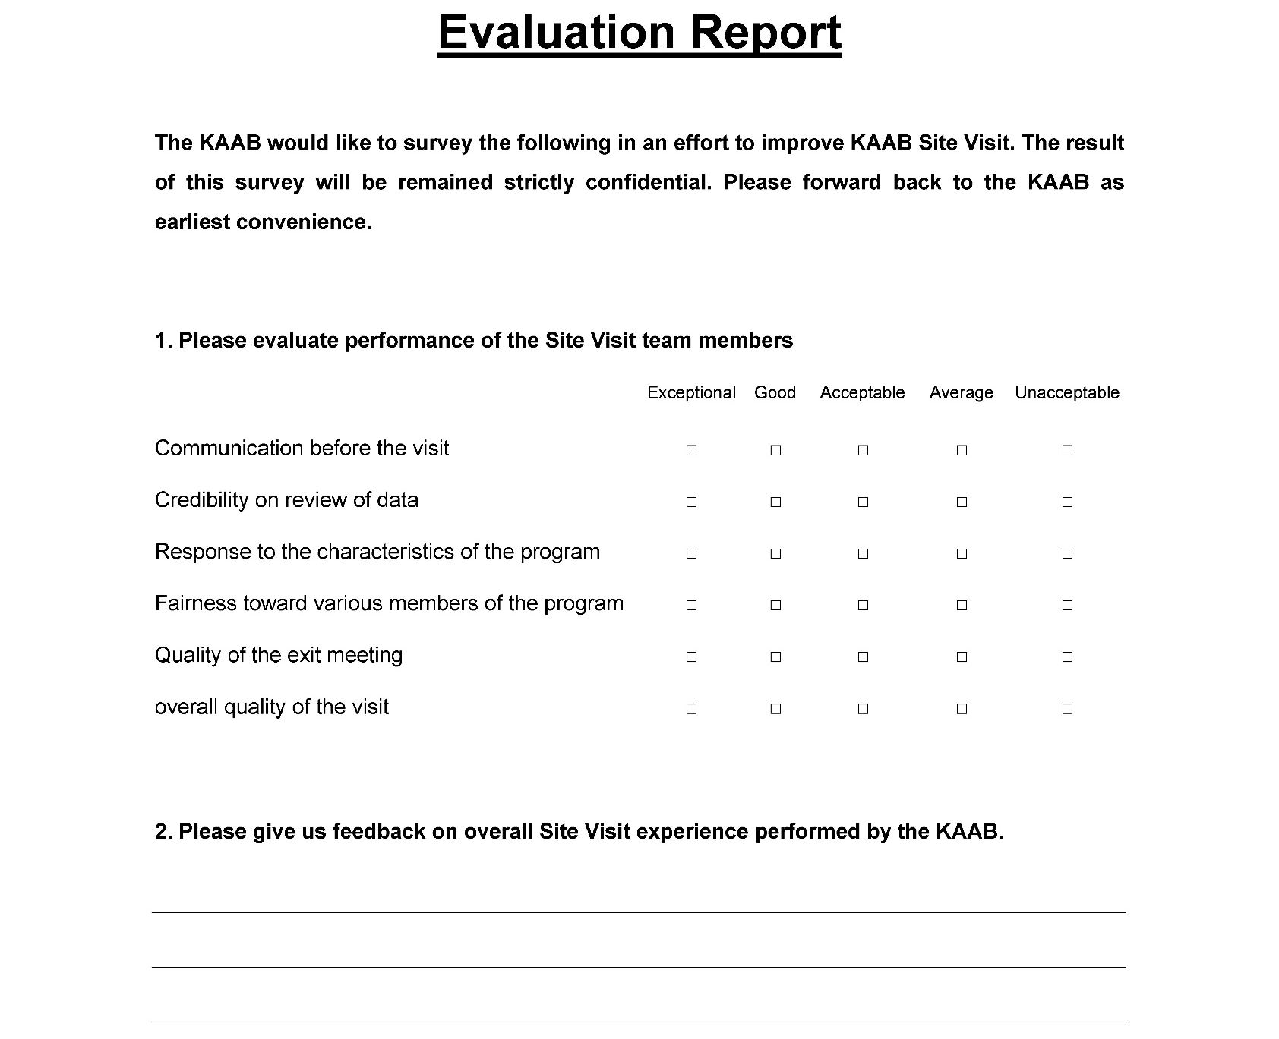
2018 Online Training 2/3
Evaluation of the Site Visit

Slide 53
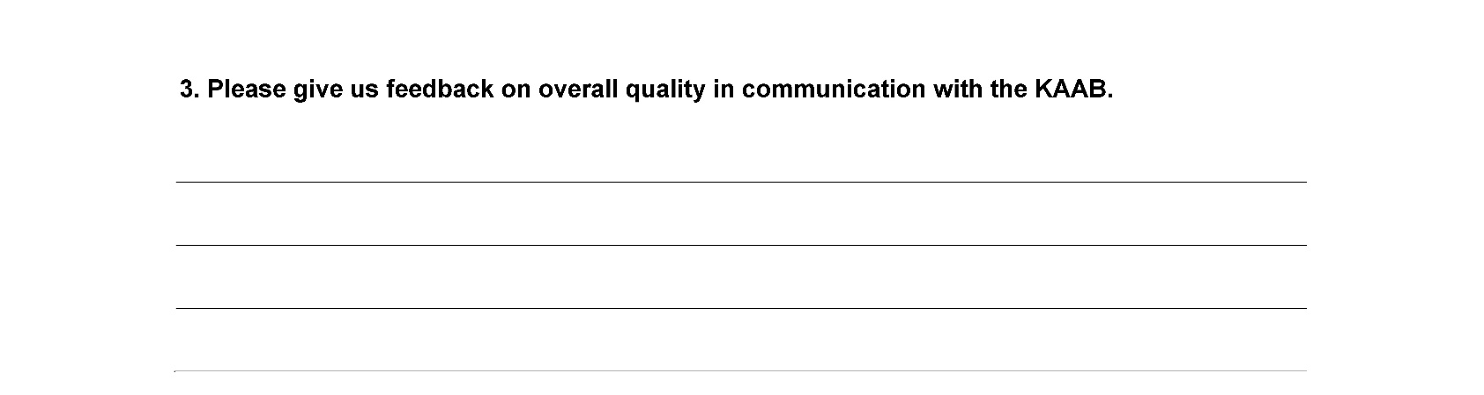
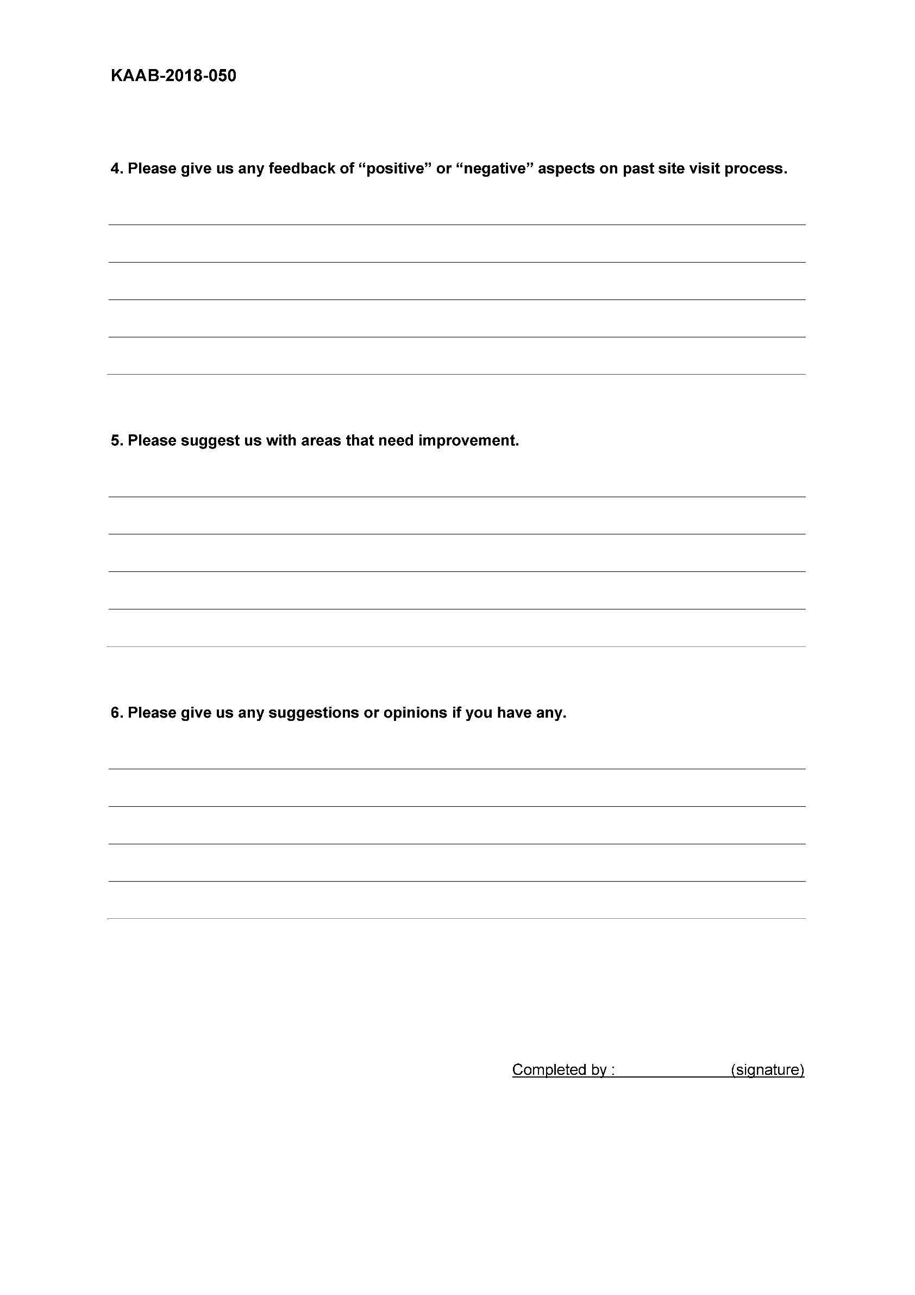
2018 Online Training 2/3
Evaluation of the Site Visit

Slide 54
2018 Online Training 2/3
Evaluation of the Site Visit

Slide 55
KAAB Site Visit Team Online Training
2018 Online Training 2/3
Visiting Team Report
Member of Canberra Accord

