Slide 1





KAAB Site Visit Team Online Training
2018 Online Training 3/3
Site Visit Overview
Member of Canberra Accord

Slide 2
Typical Site Visit Agenda - Overview
2018 Online Training 3/3
 | Day 1, Sunday |  | Day 2, Monday |  | Day 3, Tuesday |  | Day 4, Wednesday
 | Entrance meeting |  | Breakfast & Team meeting |  | Breakfast & Team meeting |  | Breakfast & Hotel checkout
 | Move to campus |  | Entrance meeting with president and other executive officers of the university |  | Review of exhibit |  | Team meeting
 | Entrance meeting with the faculty, Team Room orientation |  | Meeting with the students of the program |  | Team lunch |  | Report of the summary of the visit to program faculty members
 |  |  | Team lunch |  | Meeting with program faculty members |  | Exit meeting with president and executives of the university
 | Team lunch
 |  |  | Meeting with visiting professors or lecturers (non-full time, adjunct teaching positions)
 | Meeting with program alumni |  |  |  | Final review of the exhibit
 |  |  |  |  |  |  | Team room clean-up
 |  |  |  |  | Meeting over dinner |  | Exit meeting with all members of the program
 | Review of exhibit |  | Tour of the facility
 |  |  |  |  | Finalizing Visiting Team Report |  | Dispersion of the visit team
 | Team meeting over Dinner |  | Observation of studio, lectures
 |  |  |  |  | Finalizing Confidential Recommendation
 | Move to hotel
 |  |  | Review of exhibit
 |  |  |  |  | Move to hotel
 |  |  | Team meeting over Dinner
 |  |  | Move to hotel

Slide 3
Typical Site Visit Agenda – Day 1, Sunday
2018 Online Training 3/3
 | Time | Agenda | Key Contents | Participant (Excluding Team Members) | Venue
 | 10:30 - 13:00 | Team meeting & Lunch | Team members introduction & orientation, APR review, Gathering of questionable items, Dividing task of criteria review |  | Hotel meeting room
 | 13:00 - | Move to campus
 | 13:30 -14:20 | Entrance meeting with the faculty |  | Program faculty members | Team room
 | 14:20 -15:00 | Team Room orientation | Describing exhibits & orientation | Program faculty members | Team room
 | 15:30 - 15:40 | Meeting with program alumni | Learn about the program & gather opinions | Program alumni, within past 5 years | Team room
 | 15:40 - 19:30 | Review of exhibits |  |  | Team room
 | 19:30 - | Team meeting over dinner | Overview of findings | No external members | Outside university
 |  | Review of exhibits if needed |  |  | Team room
 |  | Move to hotel

Slide 4
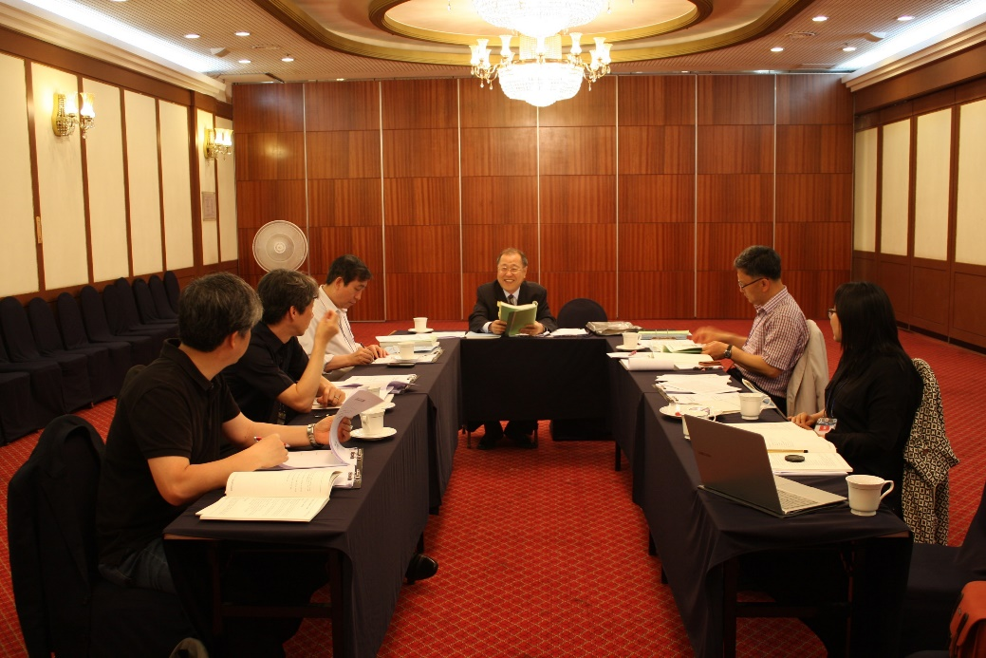
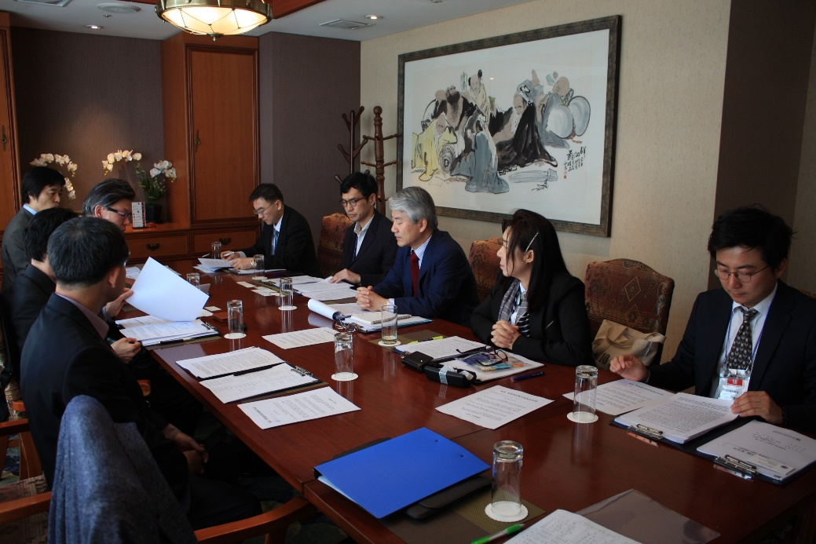
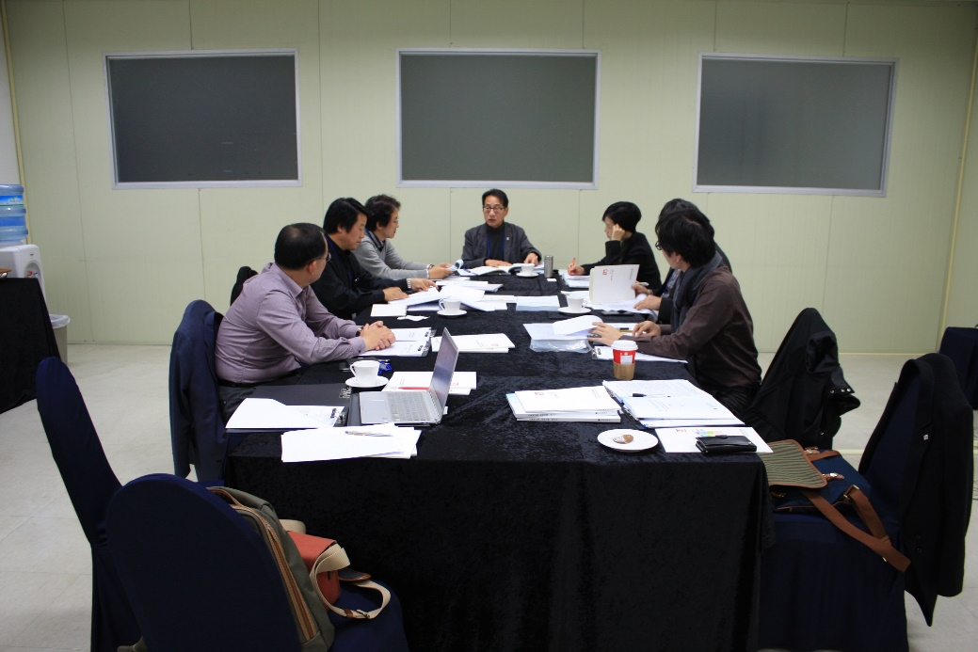
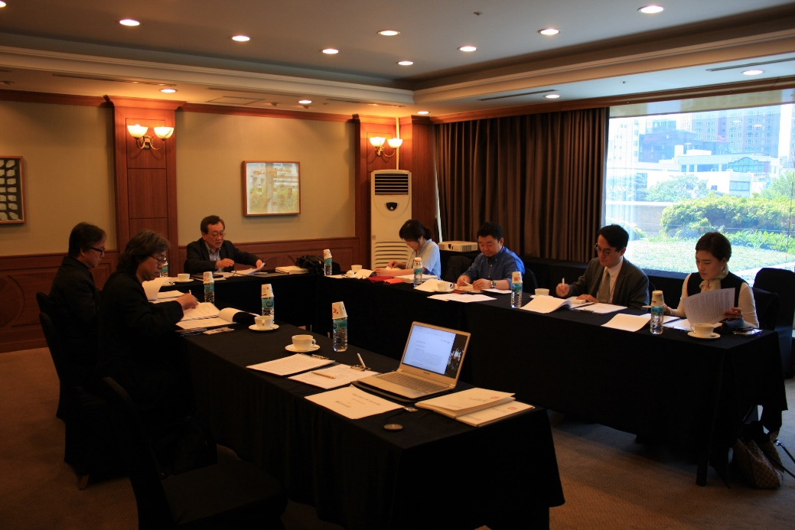
Entrance meeting with faculty members
2018 Online Training 3/3

Slide 5
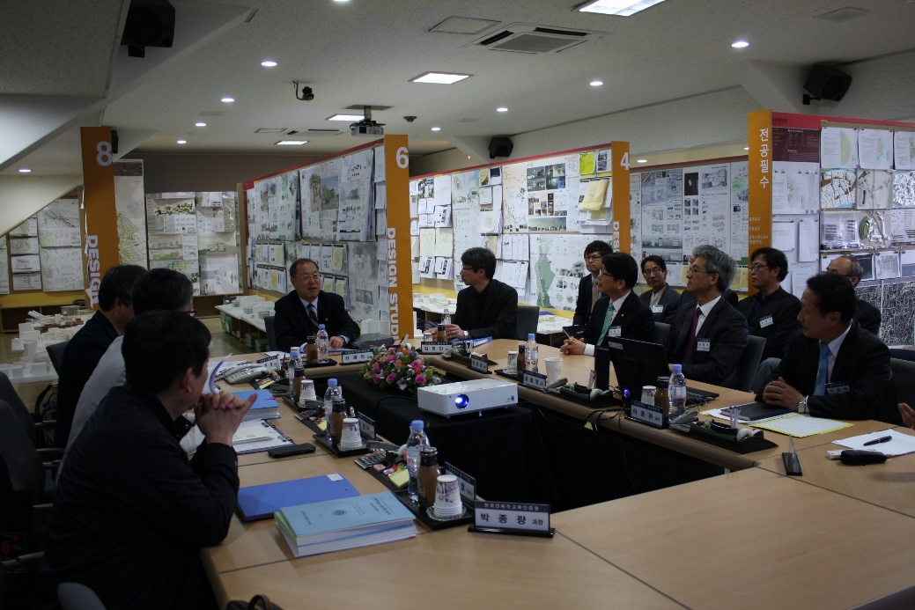
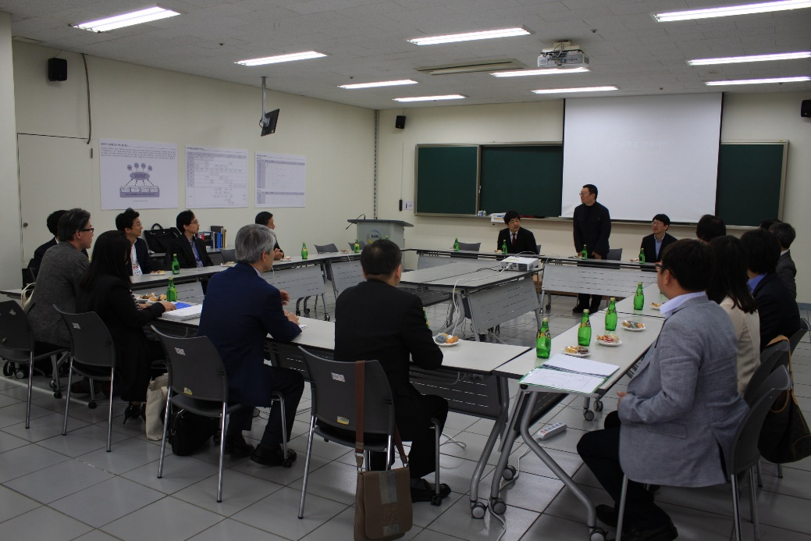
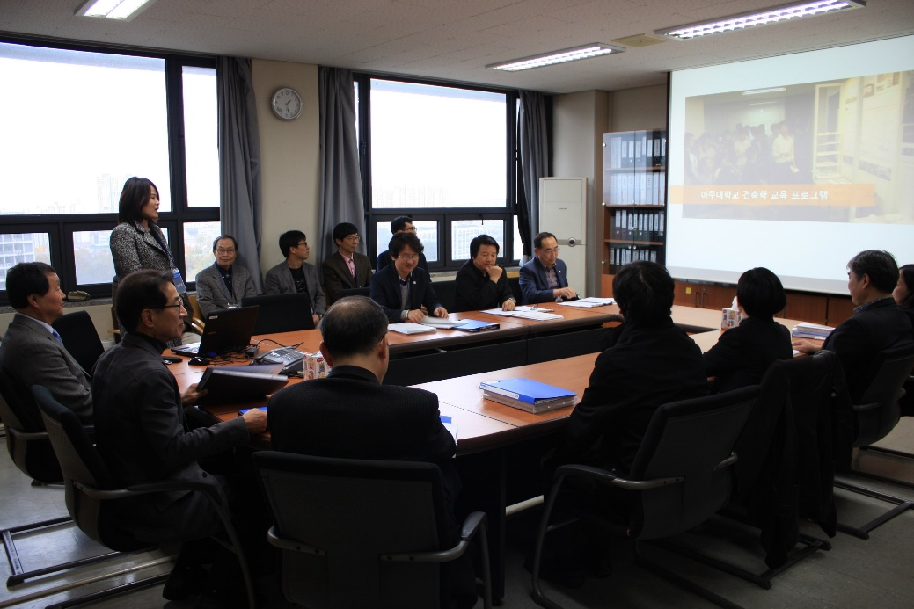
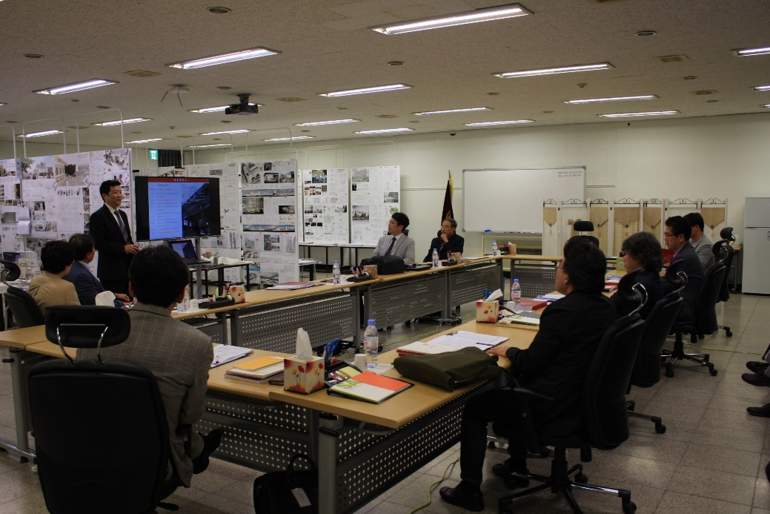
Entrance meeting & Team room orientation
2018 Online Training 3/3

Slide 6
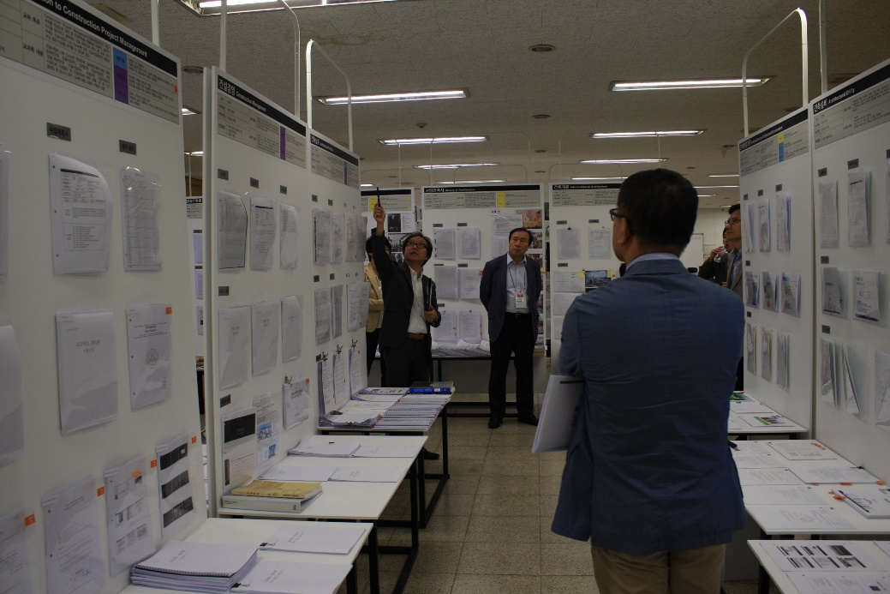
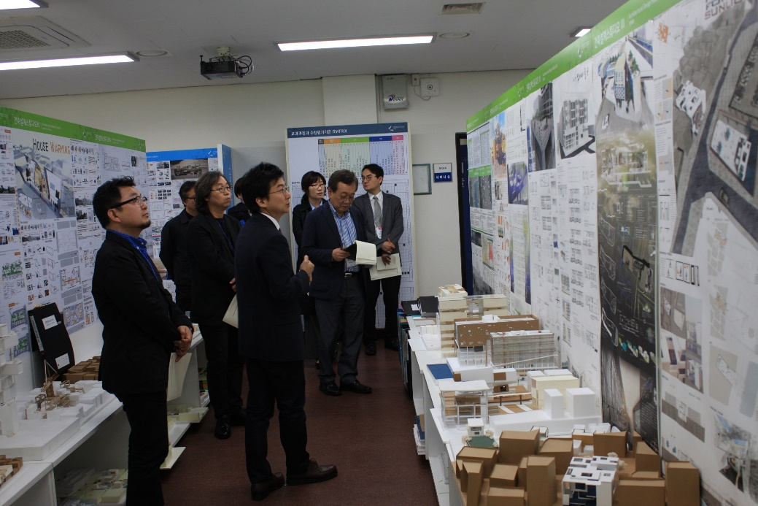
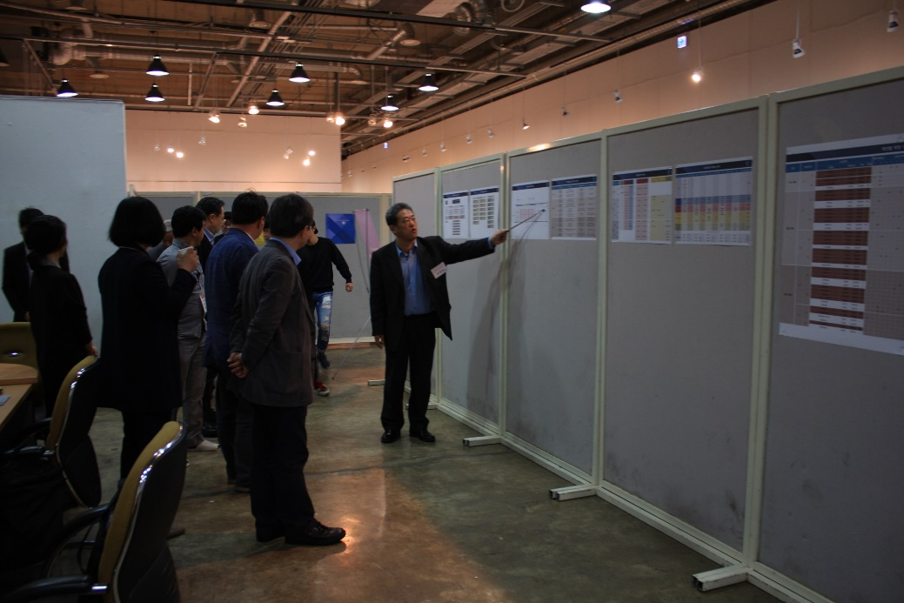
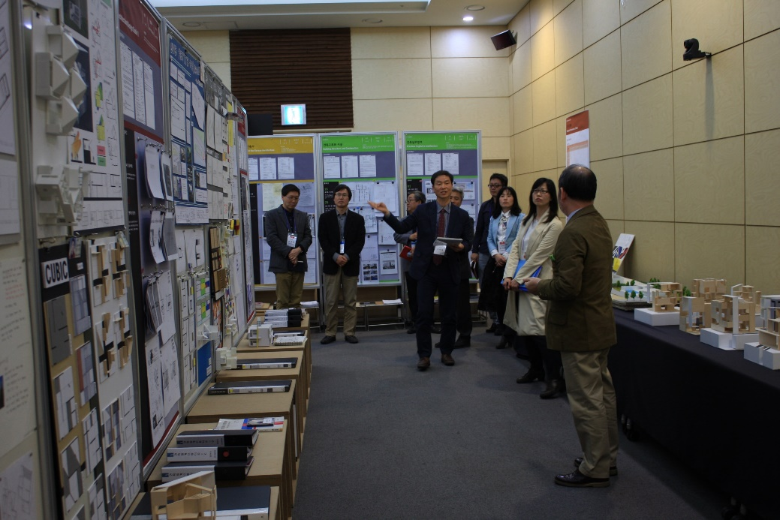
Entrance meeting & Team room orientation
2018 Online Training 3/3

Slide 7
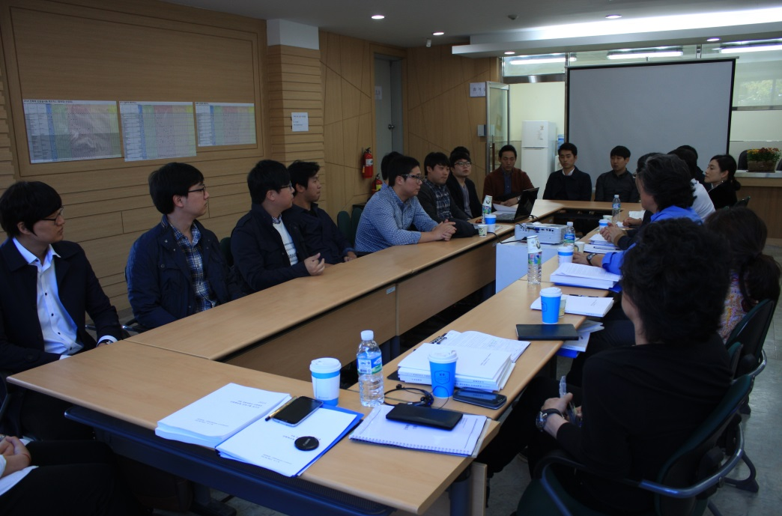
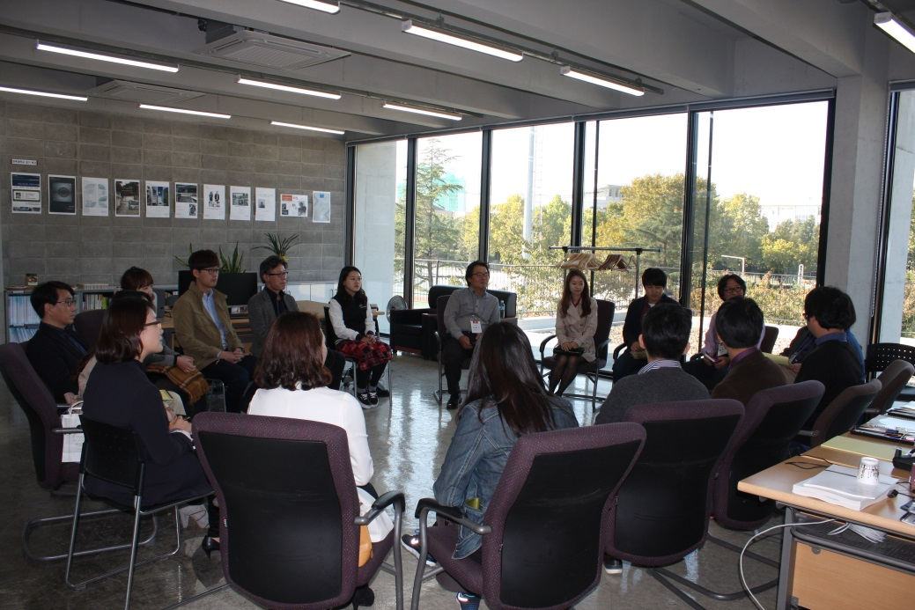
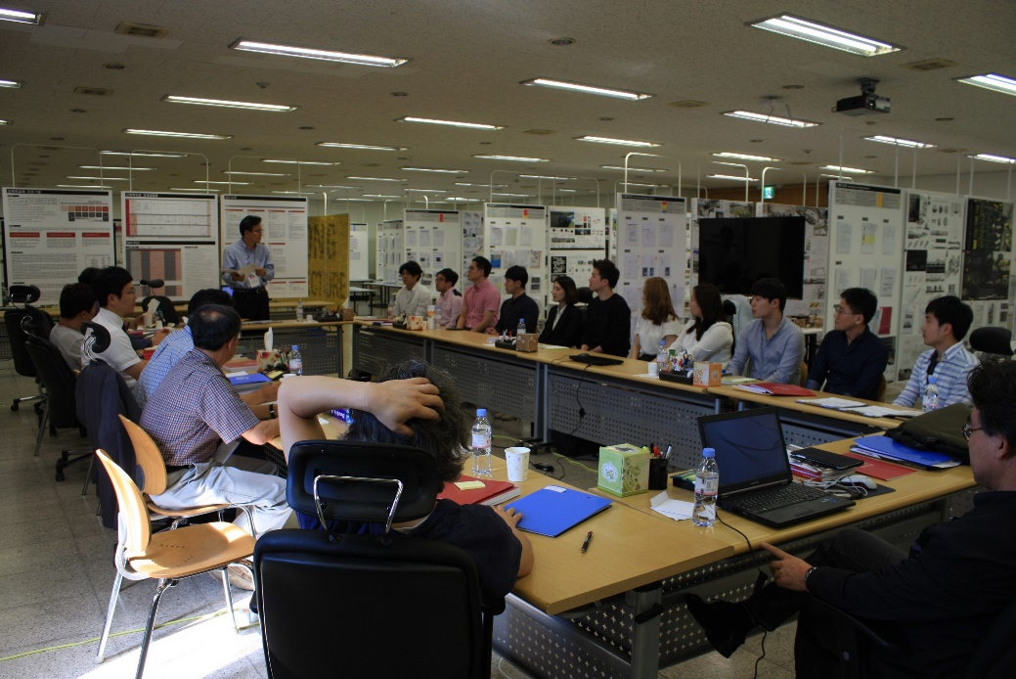
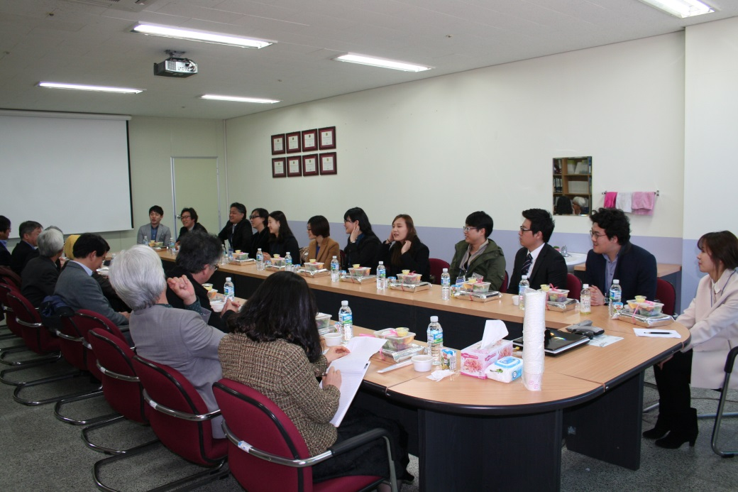
Meeting with program alumni
2018 Online Training 3/3

Slide 8
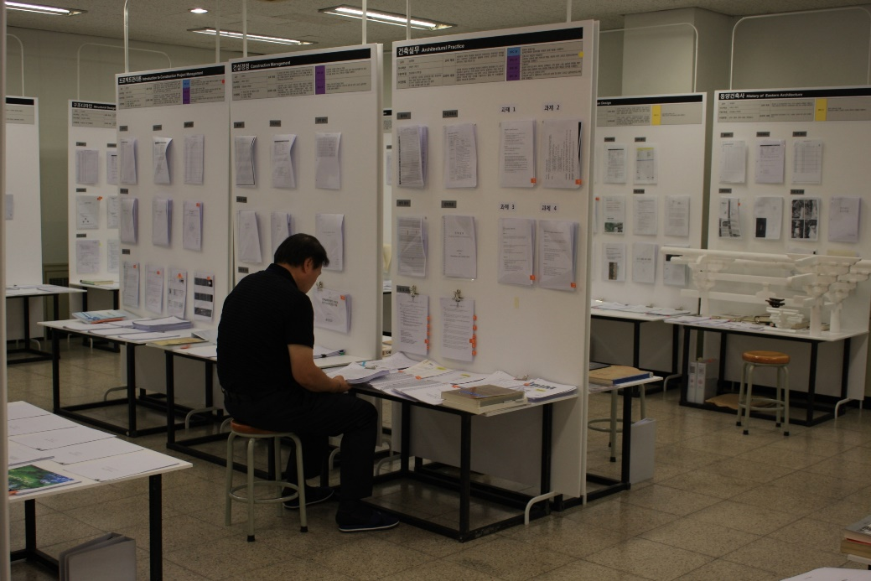
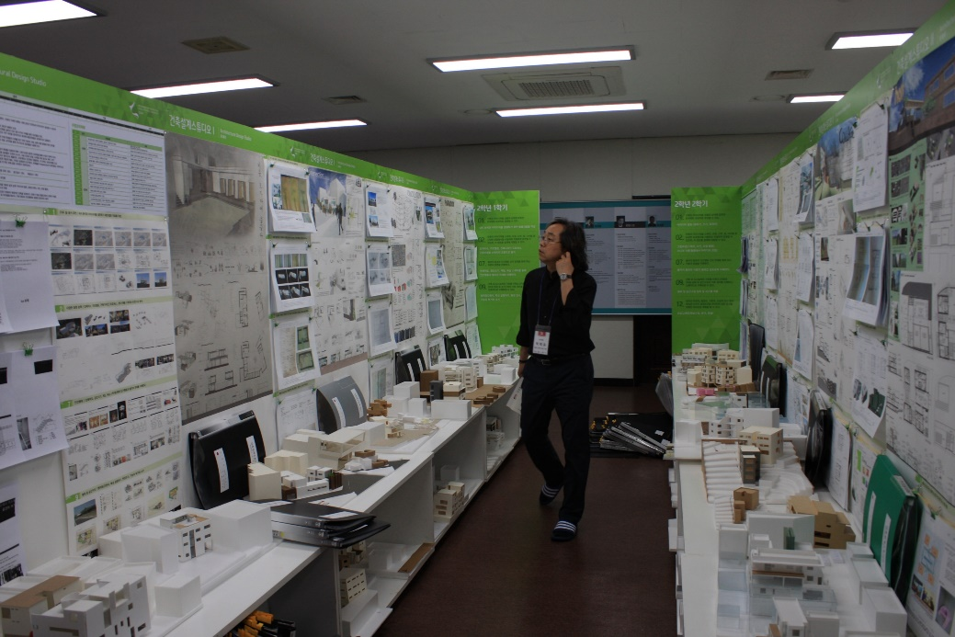
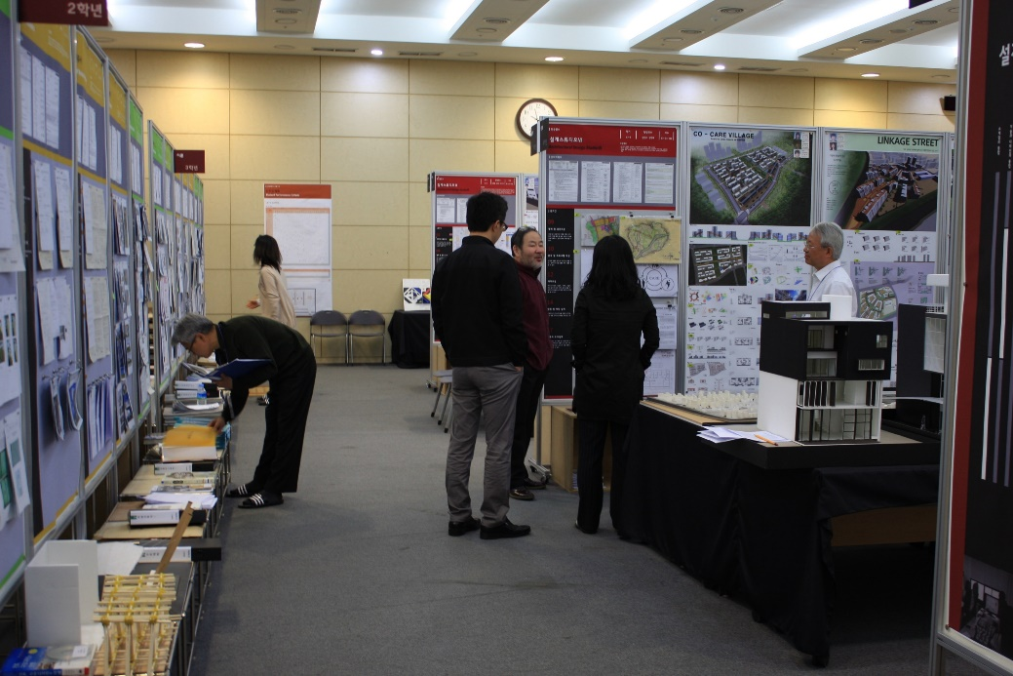
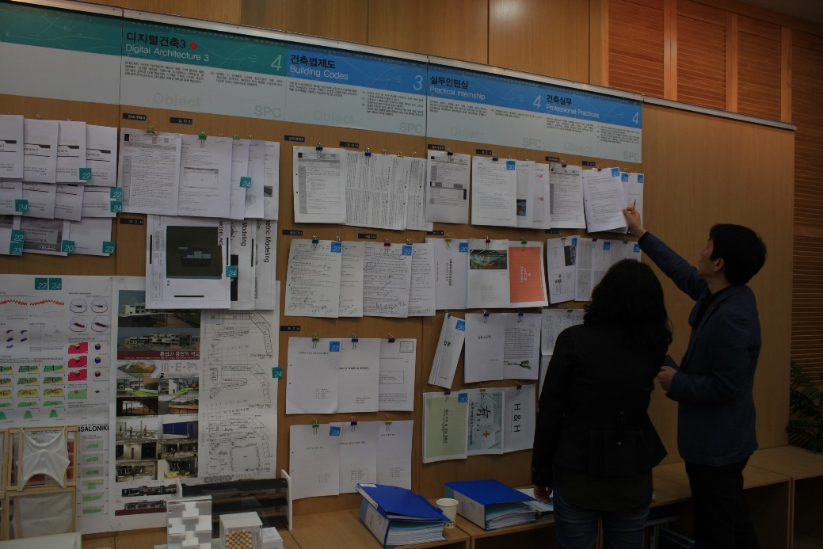
Review of exhibits
2018 Online Training 3/3
전시자료 검토

Slide 9
Typical Site Visit Agenda – Day 2, Monday
2018 Online Training 3/3
 |  | Agenda | Key Contents | Participant (Excluding Team Members) | Venue
 | 7:30 - 8:30 | Team Breakfast |  |  | Hotel
 | 8:30 - | Move to campus
 | 9:00 - 10:00 | Team meeting | Discuss agenda & etc. |  | Team room
 | 10:00 - 10:30 | Entrance meeting with president and other executive officers of the university |  | President and executive officers, excluding faculty members | President’s quarter
 | 10:30 - 12:00 | Meeting with students of the program |  | Program students, excluding faculty members | Large lecture hall
 | 12:00 - 13:00 | Team lunch |  |  | Within university
 | 13:00 - 13:40 | Meeting with visiting professors or lecturers |  |  | Team Room
 | 13:00 - 18:30 | Tour of the facility, observation of classes |  |  | various
 | 18:30 - | Team meeting over dinner | Overview of findings | No external members | Outside university
 |  | Review of exhibits if neede |  |  | Team room
 |  | Move to hotel

Slide 10
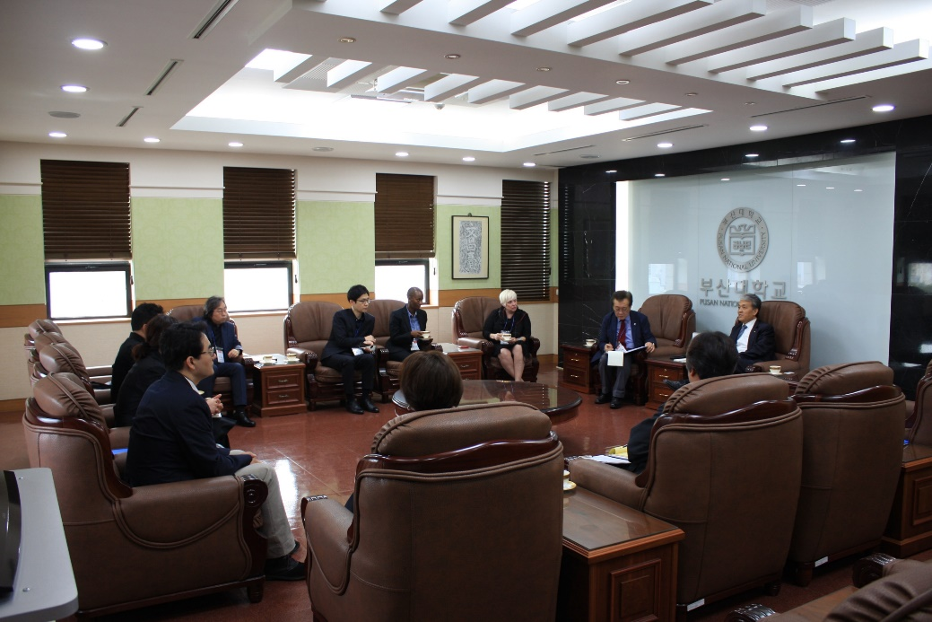
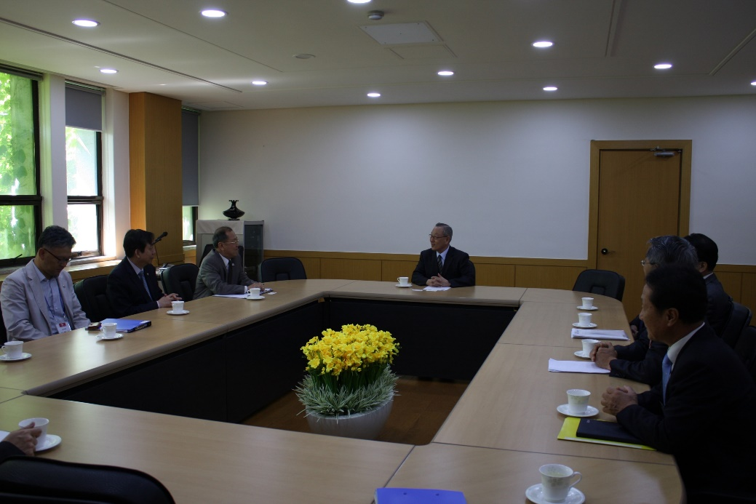
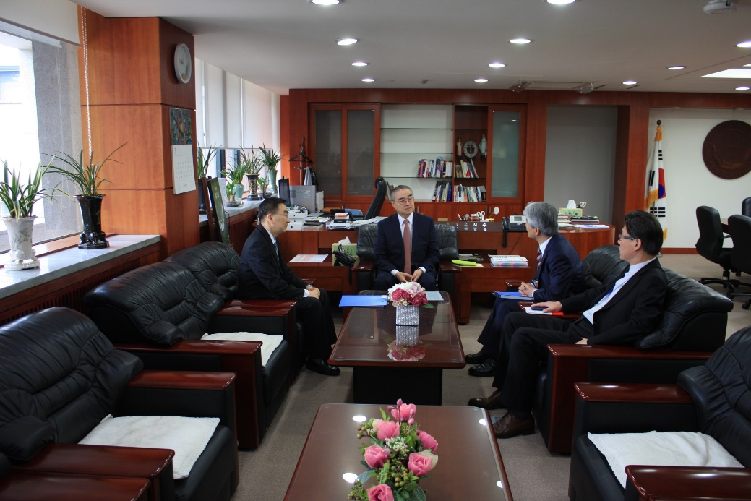
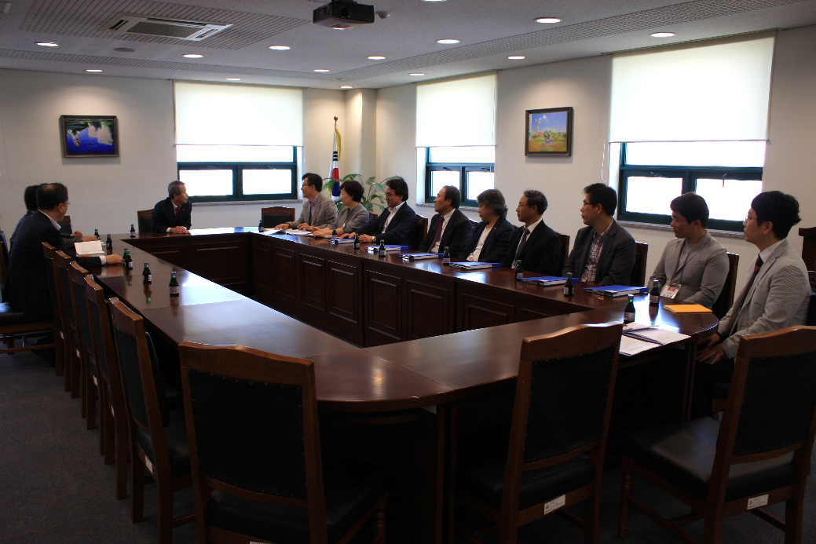
Entrance meeting with president and other executive officers of the university
2018 Online Training 3/3
전시자료 검토

Slide 11
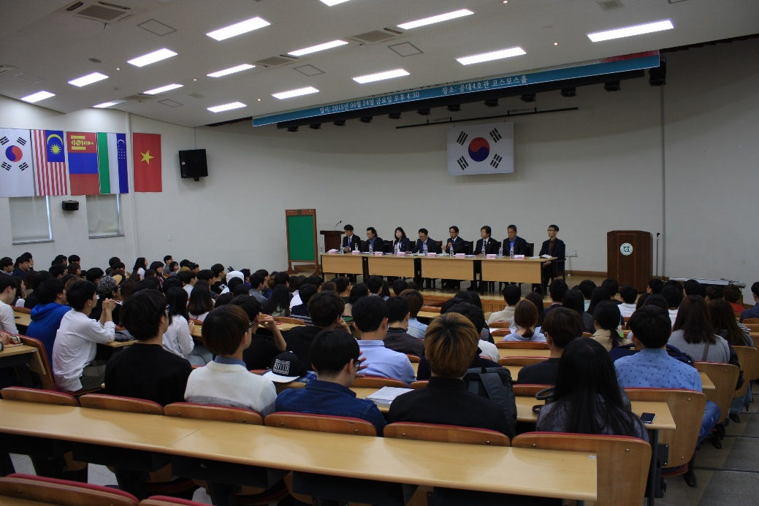
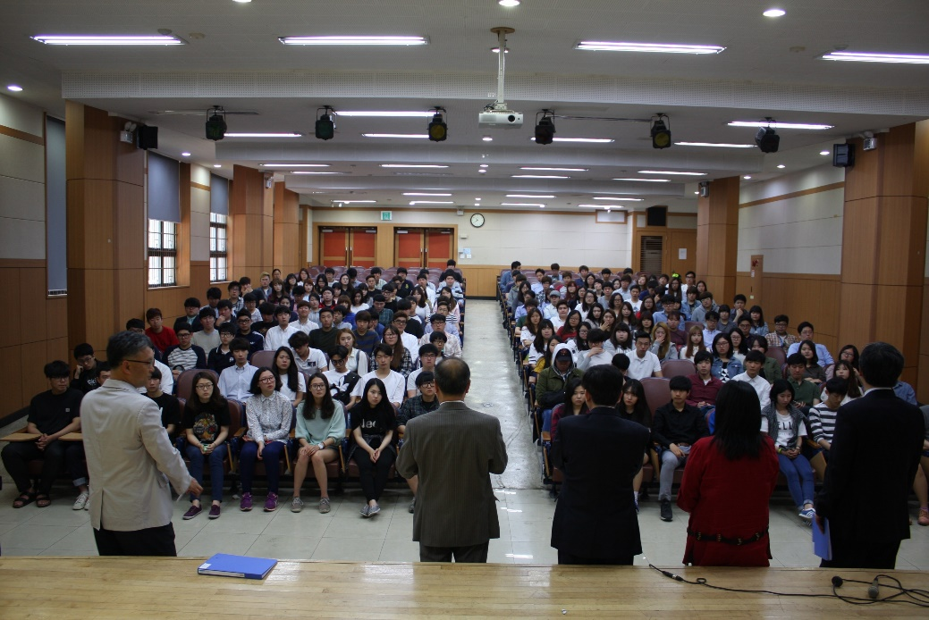
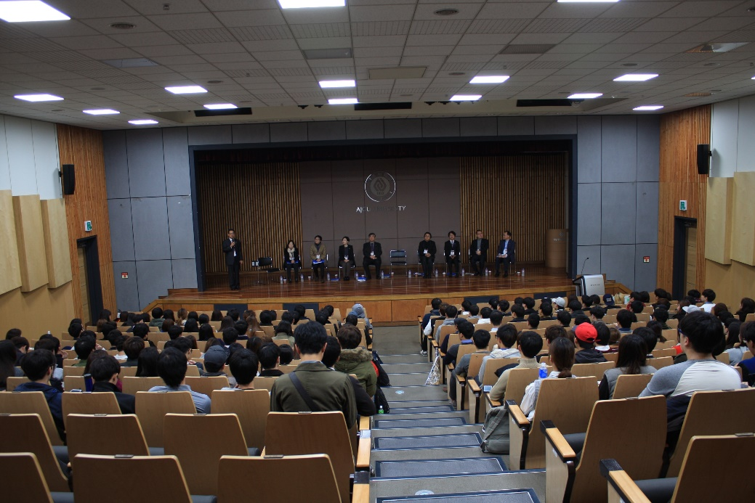
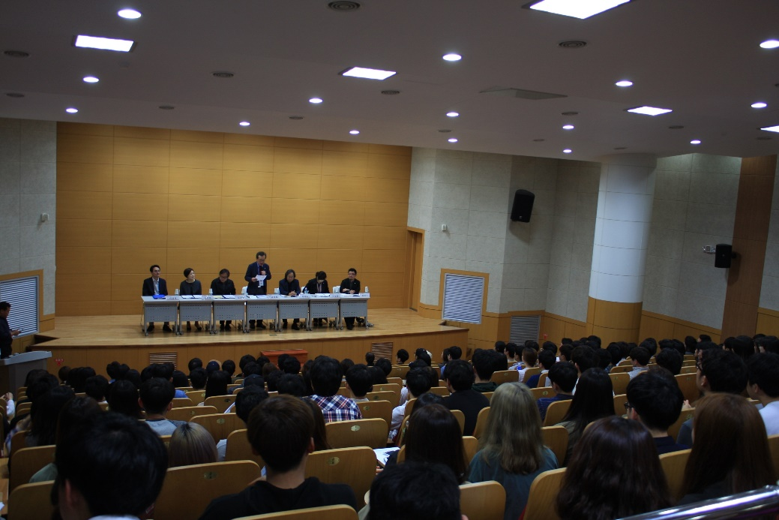
Meeting with students of the program
2018 Online Training 3/3
전시자료 검토

Slide 12
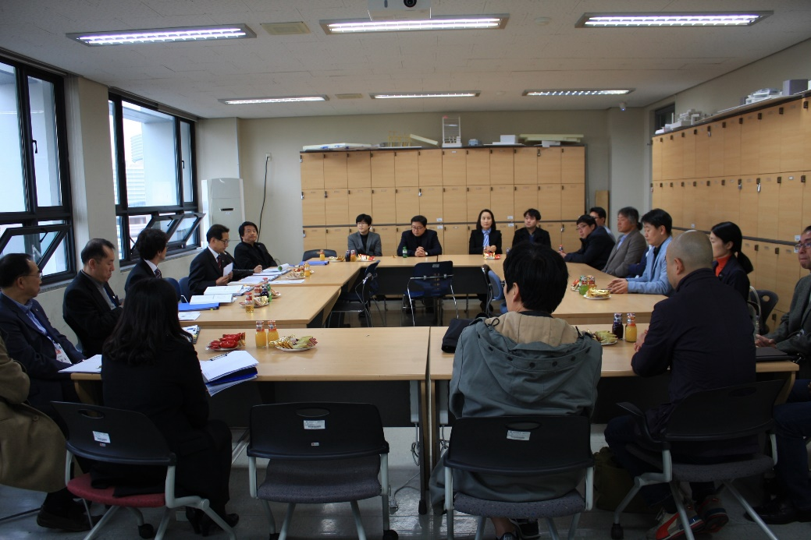
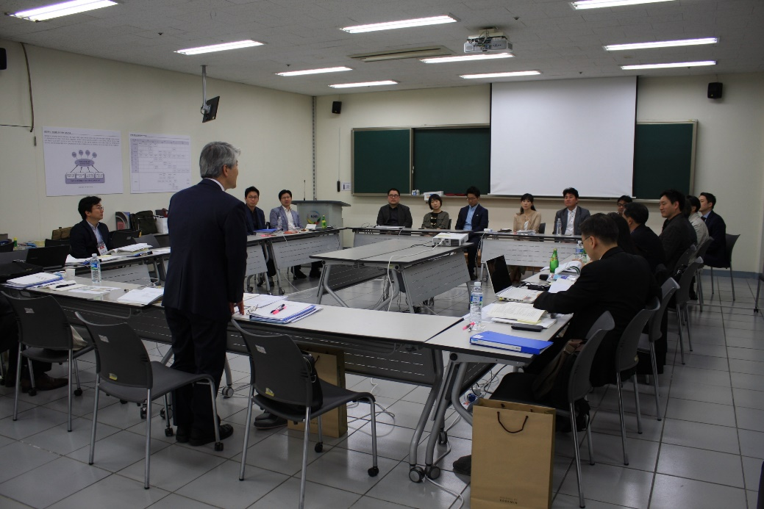
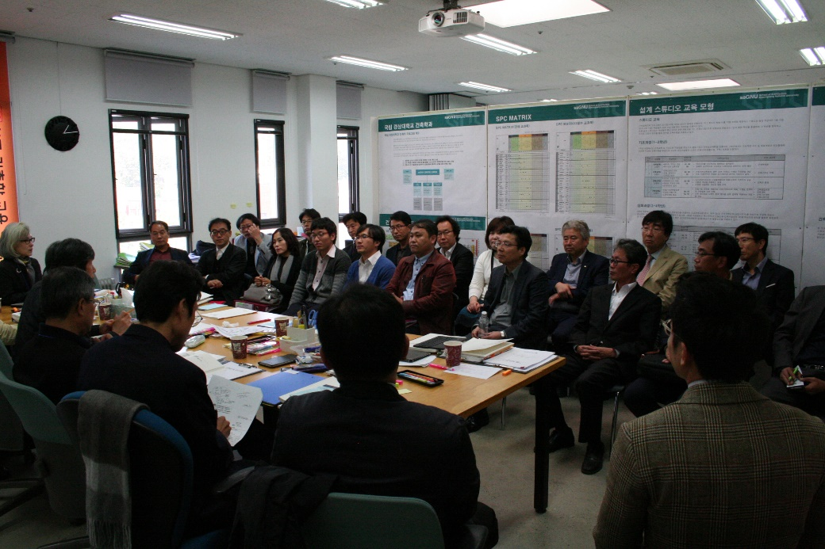
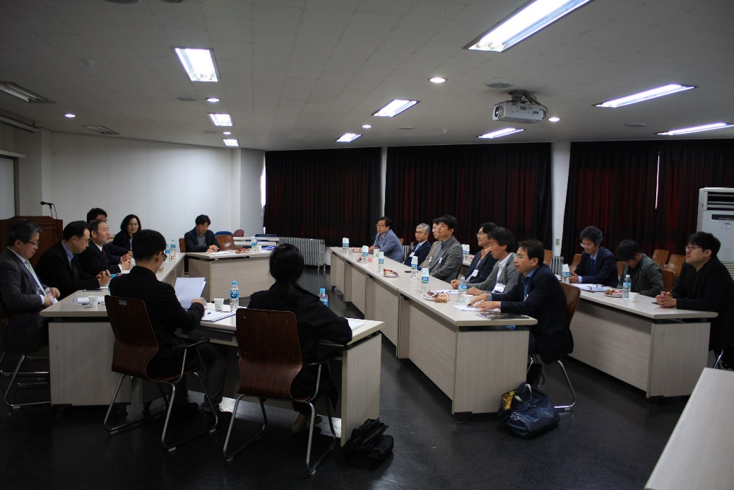
Meeting with visiting professors or lecturers
2018 Online Training 3/3
전시자료 검토

Slide 13
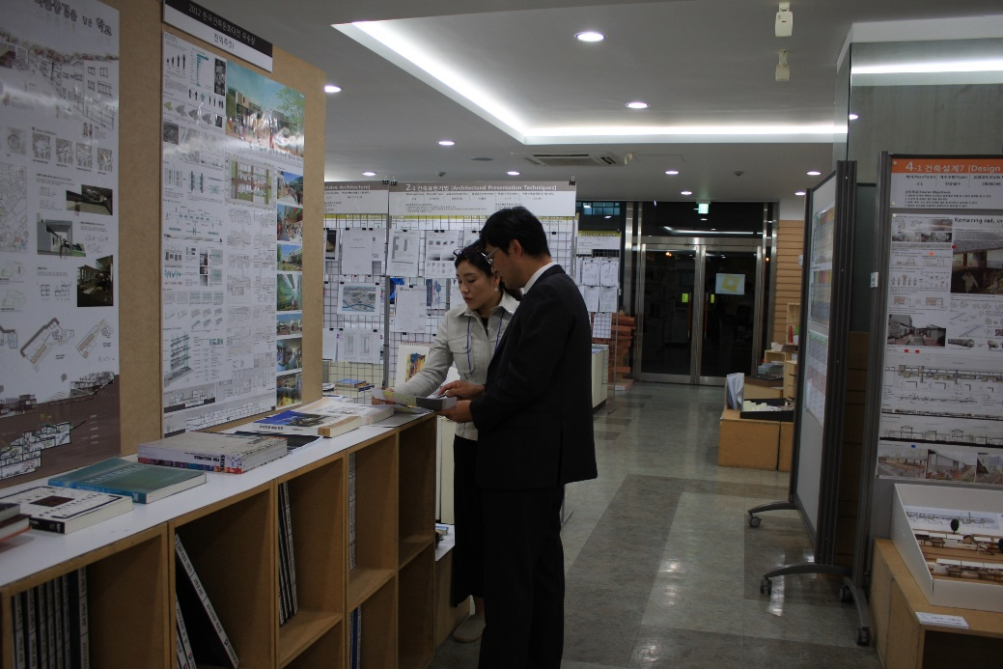
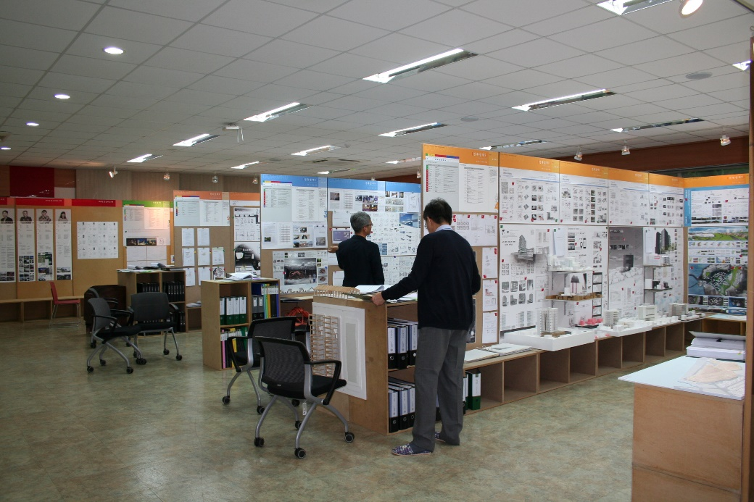
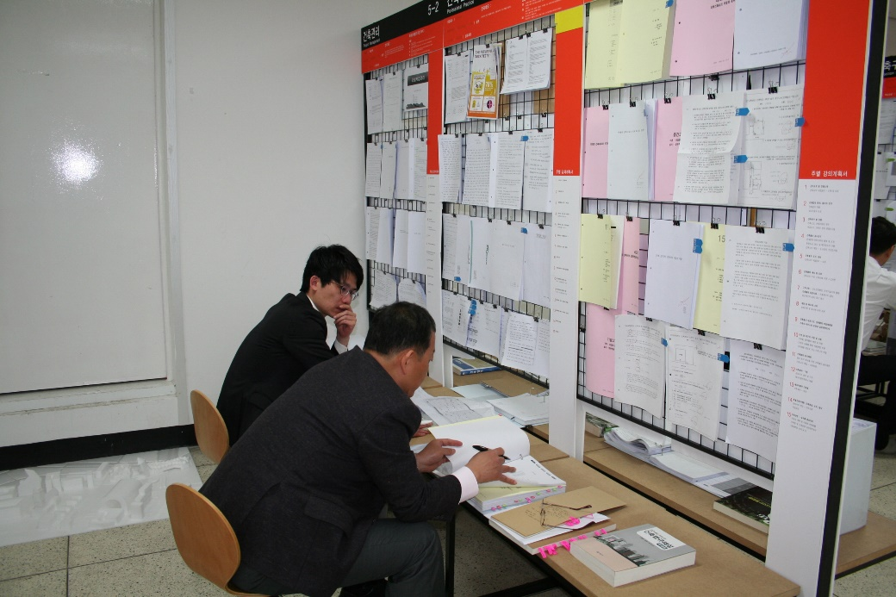
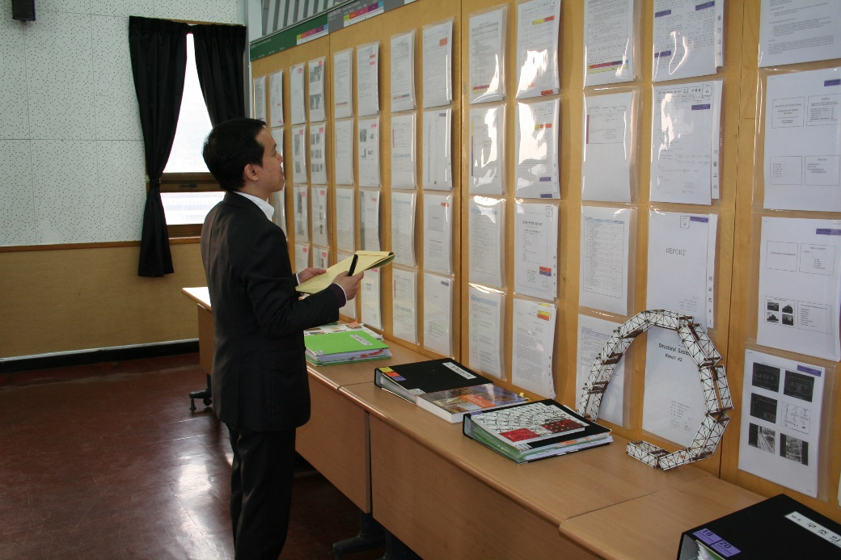
Review of exhibits
2018 Online Training 3/3
전시자료 검토

Slide 14
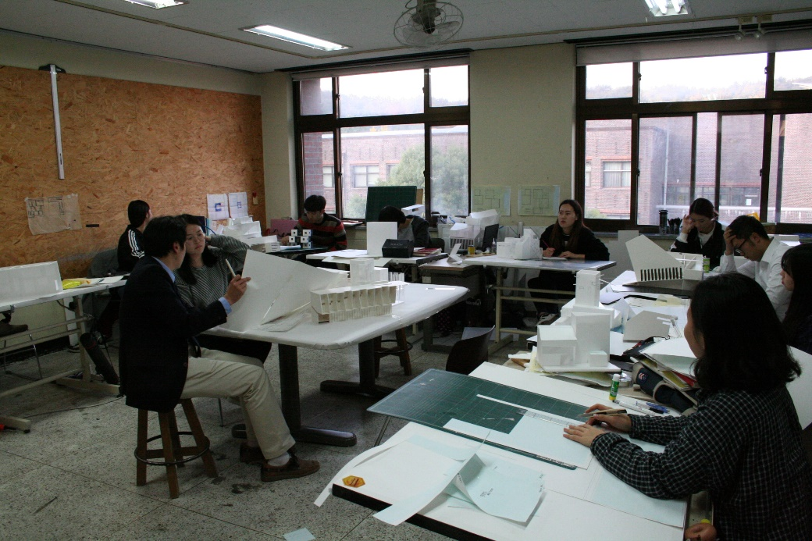
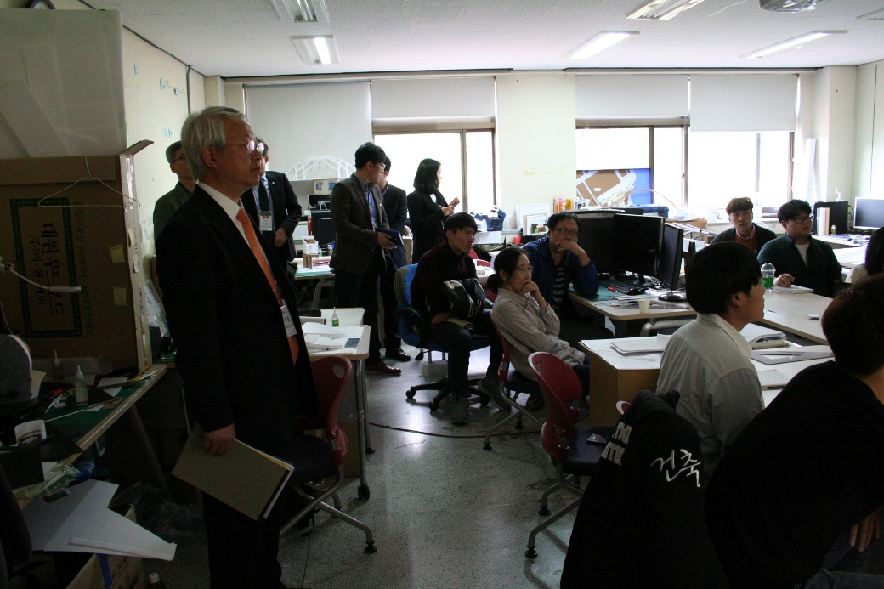
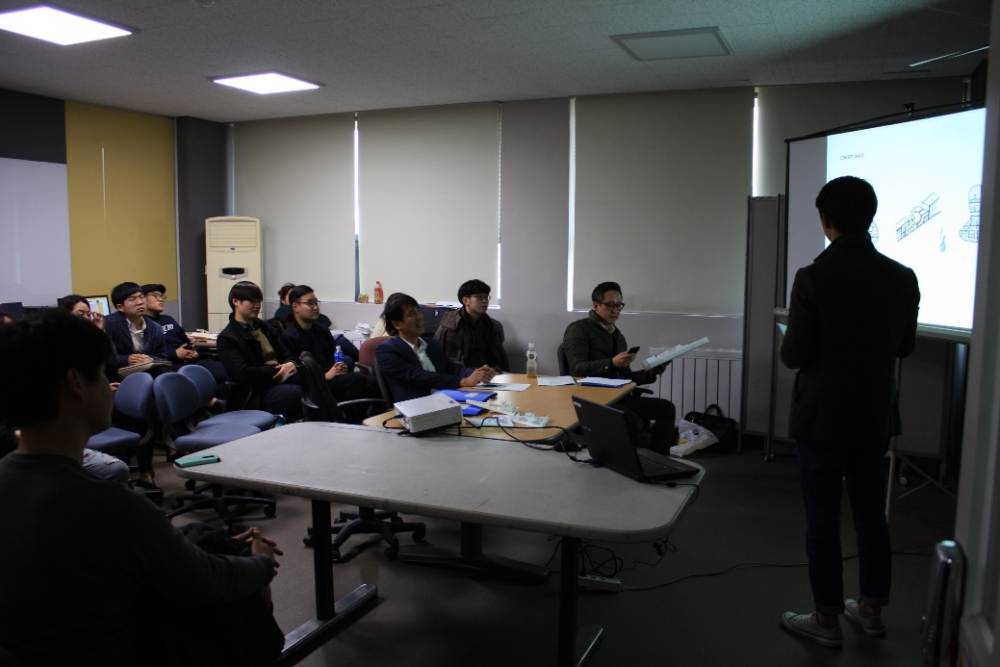
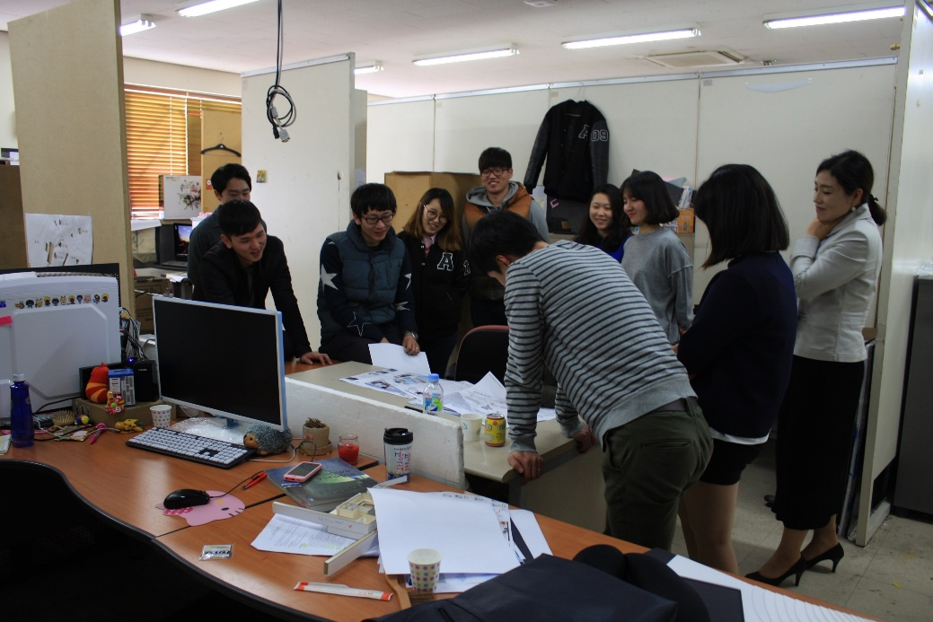
Tour of the facility, observation of classes
2018 Online Training 3/3
전시자료 검토

Slide 15
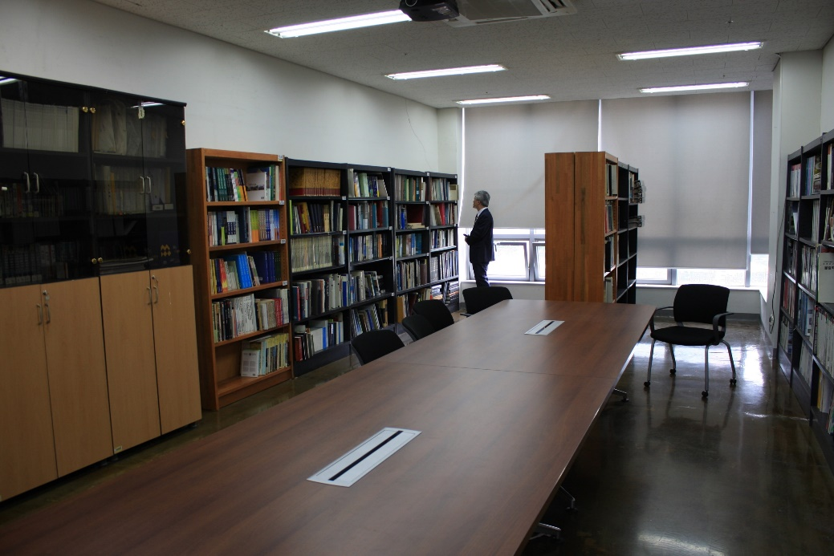
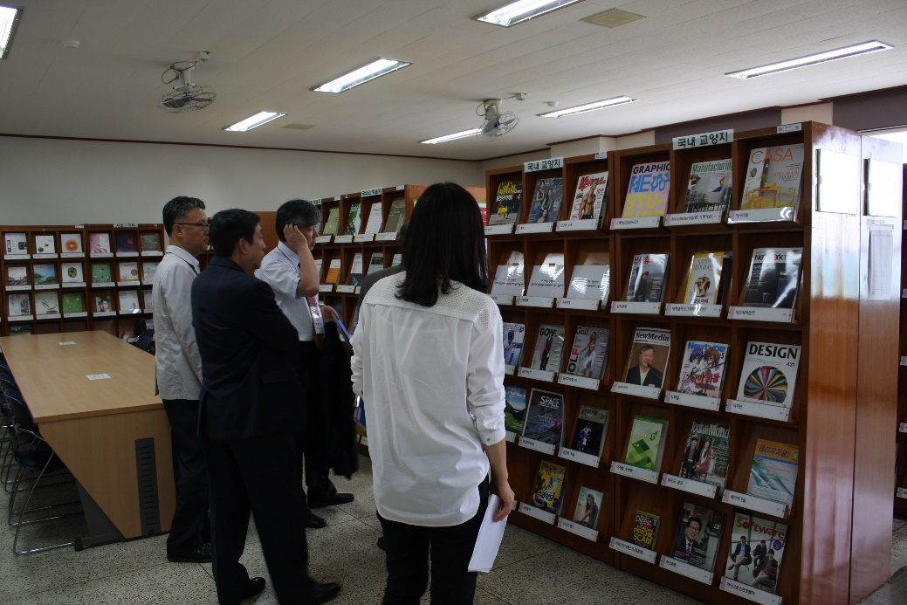
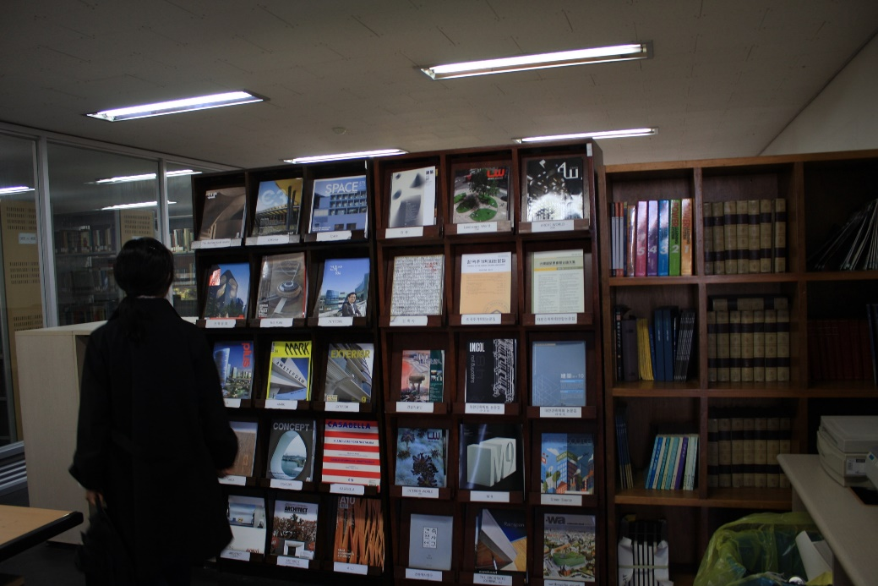
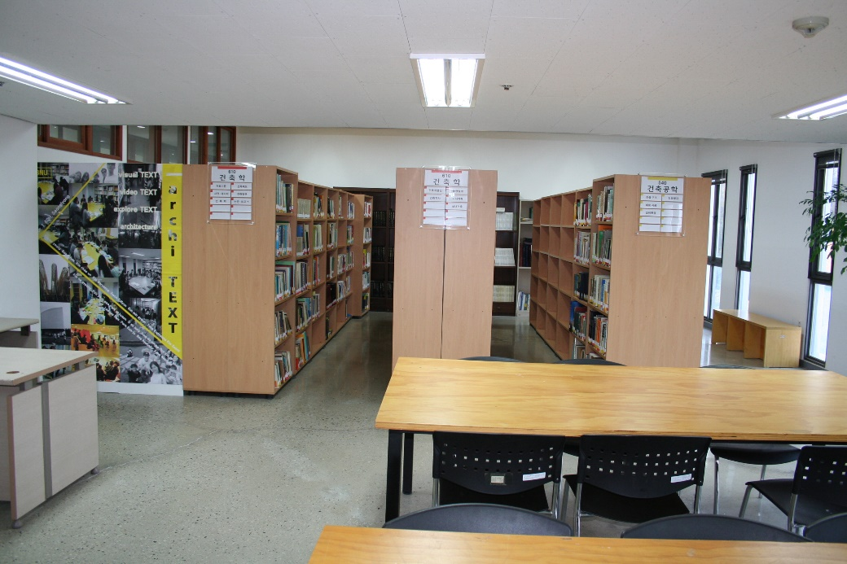
Tour of the facility - Libraries
2018 Online Training 3/3
전시자료 검토

Slide 16
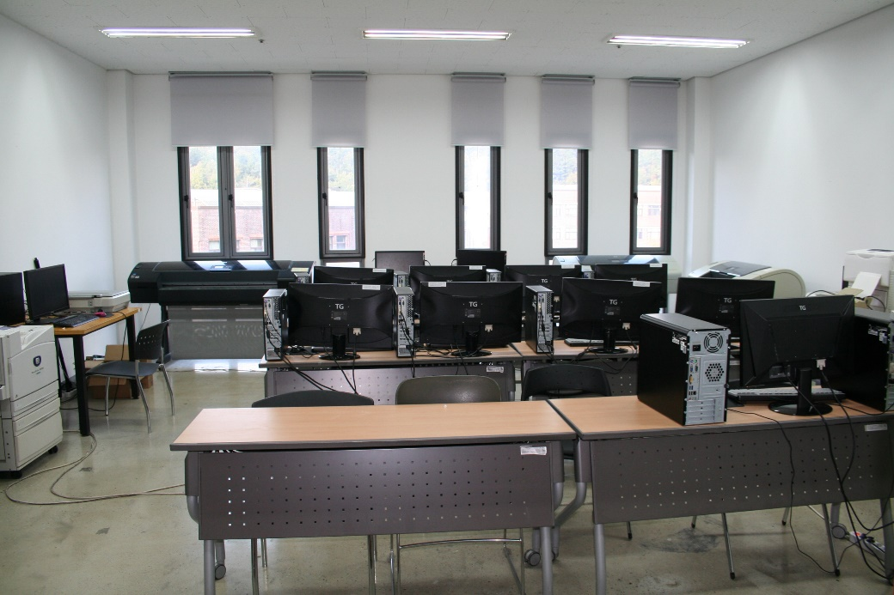
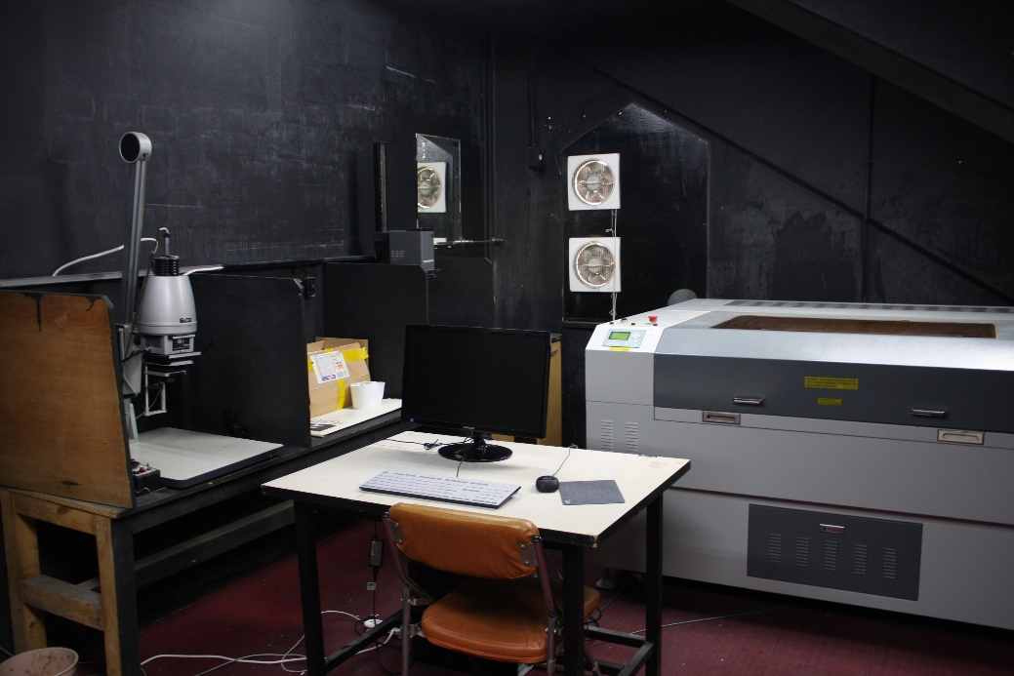
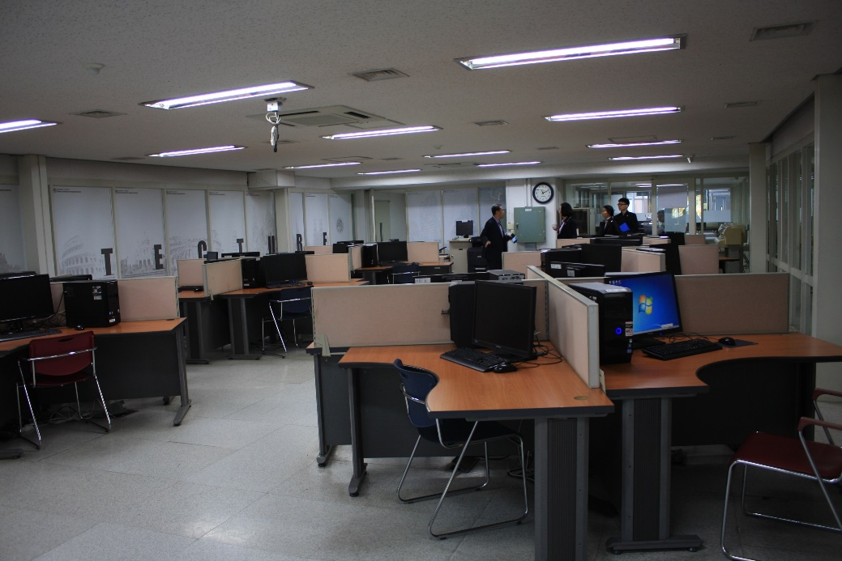
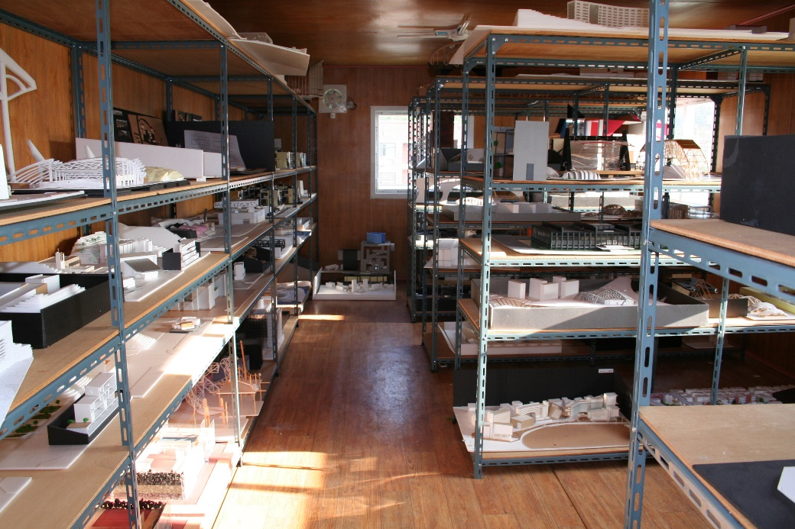
Tour of the facility - Various
2018 Online Training 3/3
전시자료 검토

Slide 17
Typical Site Visit Agenda – Day 3, Tuesday
2018 Online Training 3/3
 |  | Agenda | Key Contents | Participant (Excluding Team Members) | Venue
 | 7:30 - 8:30 | Team Breakfast |  |  | Hotel
 | 8:30 - | Move to campus
 | 9:00 - 9:30 | Team meeting | Discuss agenda & etc. |  | Team room
 | 9:30 - 12:00 | Review of exhibit |  |  | Team room
 | 12:00 - 13:00 | Team lunch |  | Program students, if needed | Within University
 | 13:00 - 14:30 | Meeting with program faculty members | Confirm questionable areas and items | Program faculty members | Team room
 | 14:30 - 18:30 | Review of exhibits, work on VTR | Work on first draft of VTR (individually) |  | Team room
 | 18:30 - 19:30 | Team meeting over dinner |  |  | Team room
 | 19:30 - ? | Finalize VTR |  | Exclude observers if needed | Team room
 |  | Finalize Confidential Recommendation |  | Exclude observers | Team room
 | ? | Move to hotel

Slide 18
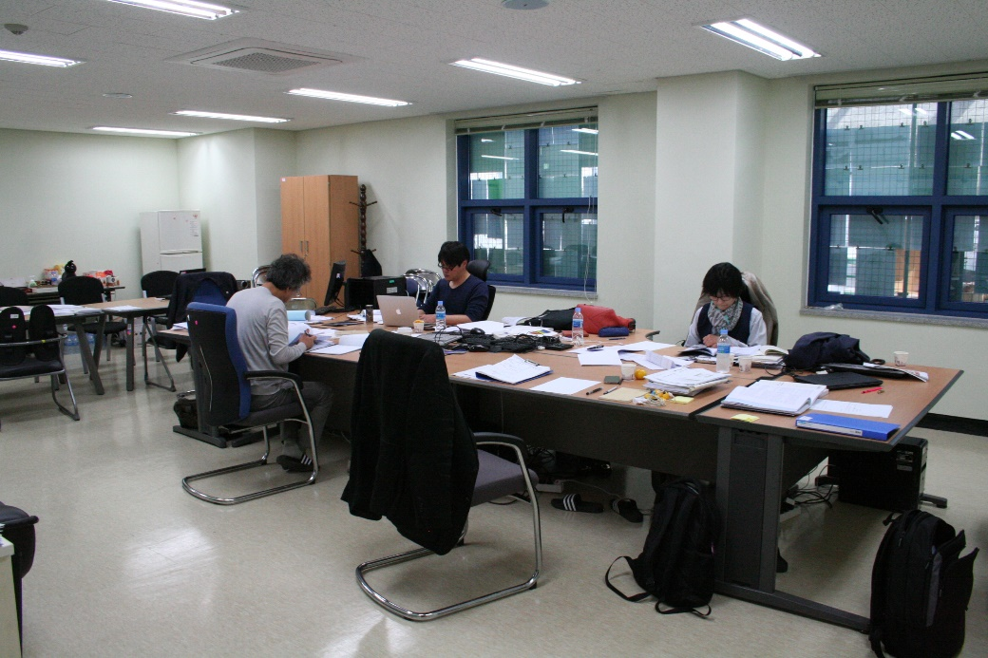
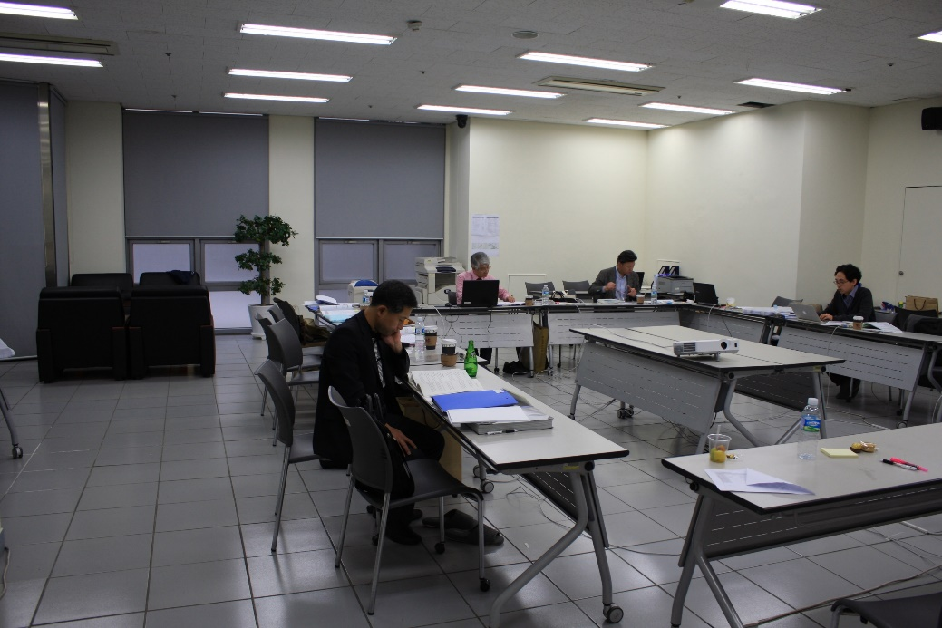


Review of exhibits & work on first draft of VTR
2018 Online Training 3/3
실사팀보고서 개별 초고 작성
전시자료 검토

Slide 19




Meeting with program faculty members
2018 Online Training 3/3
교수진과 실사진행 회의(질의 응답)
실사팀보고서 개별 초고 작성
전시자료 검토
세종대학교 인증실사
국민대학교 인증실사
아주대학교 인증실사
부산대학교 인증실사

Slide 20




Review of Exhibits
2018 Online Training 3/3
교수진과 실사진행 회의(질의 응답)
실사팀보고서 개별 초고 작성
전시자료 검토

Slide 21




Finalize VTR & Confidential Recommendation
2018 Online Training 3/3
교수진과 실사진행 회의(질의 응답)
실사팀보고서 개별 초고 작성
전시자료 검토

Slide 22
Typical Site Visit Agenda – Day 4, Wednesday
2018 Online Training 3/3
 | Time | Agenda | Key Contents | Participant (Excluding Team Members) | 장소
 | 7:30 - 8:10 | Team Breakfast |  |  | Hotel
 | 8:10 – 8:30 | Hotel Checkout
 | 8:30 - 9:00 | Move to campus
 | 9:00 – 9:30 | Team meeting | Discuss agenda |  | Team room
 | 9:30 - 10:00 | Report of the summary of the visit to program faculty members | Do not answer questions | Program faculty members | Team room
 | 10:00 - 10:30 | Exit meeting with president and executives of the university | Do not answer questions | President and executive officers, excluding faculty members | Team room
 | 10:30 - 11:00 | Team room clean-up | Eradicate sensitive materials |  | Team room
 | 11:00 - 11:40 | Exit meeting with all members of the program | Briefing of overall results, do not answer questions | All members of the program | Large lecture hall
 | 11:40 - | Dispersion of the visit team | Immediately leave the vicinity
 |  | Team lunch | Announce follow-up procedures | No external members | Outside of University

Slide 23




Report of the summary of the visit to program faculty members
2018 Online Training 3/3
교수진과 실사진행 회의(질의 응답)
실사팀보고서 개별 초고 작성
전시자료 검토

Slide 24




Exit meeting with president and executives of the university
2018 Online Training 3/3
교수진과 실사진행 회의(질의 응답)
실사팀보고서 개별 초고 작성
전시자료 검토

Slide 25




Exit meeting with all members of the program
2018 Online Training 3/3
교수진과 실사진행 회의(질의 응답)
실사팀보고서 개별 초고 작성
전시자료 검토

Slide 26
KAAB Site Visit Team Online Training
2018 Online Training 3/3
Site Visit Overview
Member of Canberra Accord

